Slide 1
X2Vol
Keeping track of service hours
EVERY student in the building is eligible to earn a Service Cord
to be worn at graduation.
The Service Cord is the only graduation cord available that is not dependent on grades, skills, or ability, but simply on commitment to service as demonstrated through 40 hours of service while at LHS.
Let’s encourage every student to walk wearing a Service Cord.

Slide 2
x2VOL is the tool FCPS middle and high schools use to support students with finding, tracking, and verifying service hours electronically. Here's how your student can sign up: Sign into Family Connection. Login to Blackboard and look for the Family Connection link.

Slide 3
Click on the x2VOL link under the "Resources" tab on the left hand side of your screen in Family Connection. Click "Continue."

Slide 4
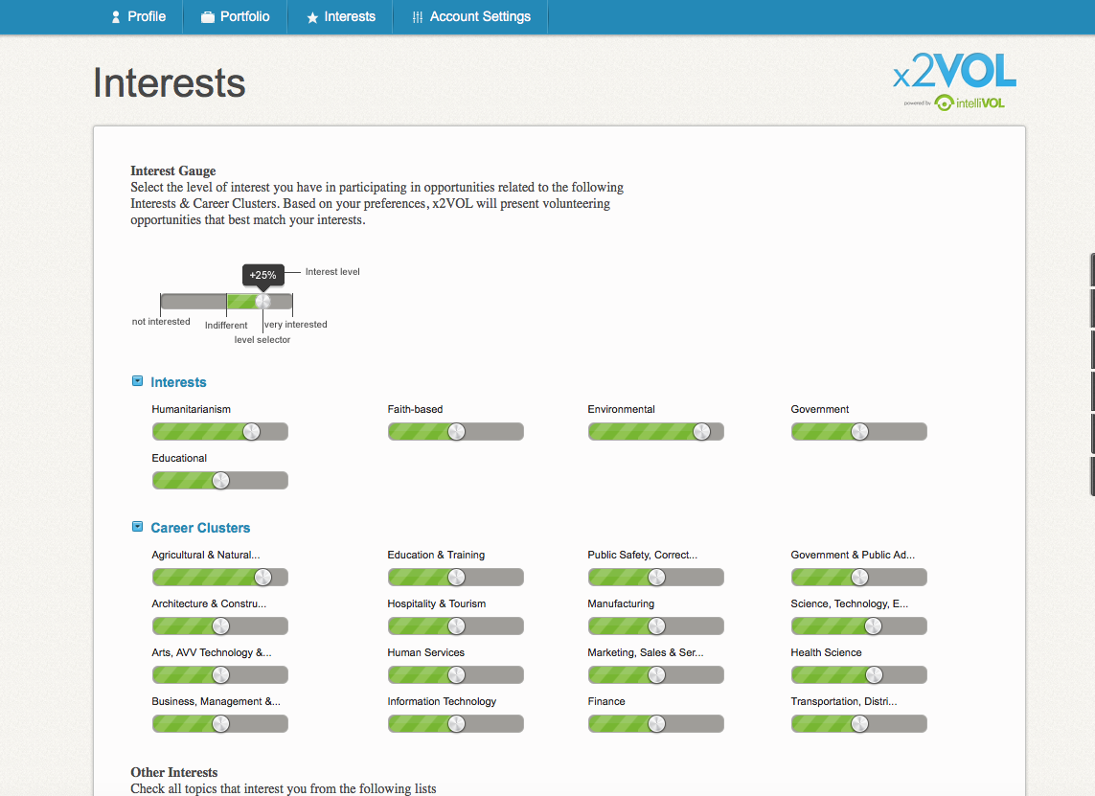
The first time you access x2VOL, you will need to complete your x2VOL profile before logging hours. Once your profile is complete, you'll still be on the account settings page of your profile, but now you have access to the rest of x2VOL and can begin to log your hours.

Slide 5
With your x2VOL password, you should be able to access x2VOL from any phone or device, making logging and tracking your volunteer hours a cinch. The next time you access x2VOL, you'll start on your Dashboard page.

Slide 6
The Find Opportunities button opens a listing of Saxon Service activities and other opportunities listed on X2Vol.

Slide 7
All Saxon Service opportunities are listed on the Opportunities & Projects tab under Find Opportunities. Click on the Saxon Service date you participated in. Betsy Shomaker, enshomaker@fcps.edu) is Activity Contact for all Saxon Service opportunities. Please include the date of the service, the activity you participated with, and the amount of time. (Each Saxon Service period is worth one hour of service.)

Slide 8
If you want to add an opportunity that is not listed in x2Vol, simply click on Add Hours button at the top of the page on the Dashboard.

Slide 9
My Activity Log will open, go to Personal Project and click on Create New to enter a new volunteer activity

Slide 10
When adding an outside opportunity; be sure to include the contact information of the person who verified the hours. Since this is not a school activity, Mrs. Shomaker can only authorize the addition of these hours to X2Vol but cannot VERIFY the hours. Include the date of service and amount of time; and check the oath statement verifying the accuracy of the information and submit the activity to Mrs. Shomaker at enshomaker@fcps.edu

Slide 11
For more information about X2Vol and how to add hours,
please visit this brief video tutorial
https://myintellivol.desk.com/customer/en/portal/articles/1598832-how-do-i-log-hours-in-x2vol-

