Slide 1
Welcome to Langley High School!
Class of 2022
Notes:
Intro Who we are at Langley High School. Purpose of the presentation is to inform you of the curricular aspect of LHS so that you can have a good discussions with your course selection for next year.

Slide 2
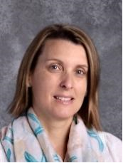
Administrators
Principal: Fred Amico
Assistant Principal: Mary Landis
AP for the Class of 2022.
Notes:
At Langley HS, we have a principal but then an AP that stays with class until graduation. The Principal oversees the school but the AP is your direct line to administration if you have a concern or problem. Questions go to Ms. Moore before Mr. Amico. Ms. Moore will be in charge of any discipline with the class of 2021.

Slide 3
Langley High School PTSA www.ptsalangley.org Patty Burgess, PTSA President 2018-2019 pcburgess1201@gmail.com What can I do to support my child’s success in high school?
Join PTSA – donate and volunteer!
PTSA website and Langley E-News – subscribe now!
PTSA meeting – attend for informative updates!
Class Forums & Coffees – grade-specific information
Freshmen Orientation for students and parents in August
Boosters for Sports, Music, Academics – get involved!
Upcoming PTSA/Student Service Program
Thursday, March 15 at 7:00pm in LHS Auditorium
The Self-Driven Child
by Bill Stixrud and Ned Johnson

Slide 4
Student Services Department
Registrar
Mary Gratz
School Social Worker
Donna Barnsley
School Psychologist
Jason McBeth
Director
Davina R. Johnson
School Counselors
Mike Johnson (A-Chang)
Alex Mantel (Chap-Gan)
Susan Murphy (Gao-Jua)
Tim Ready (Jub-Matu)
Jennifer Baldesare (Matz-Pride)
Katie Robinson (Prit-Sun)
Nichole Bernard (Suo-Z)
Notes:
Counselors do:
Schedule changes
Schedule parent/teacher conferences
Facilitate 504 meetings
Keep your students on track for meeting graduation requirements
Provide individual and group counseling when necessary
Help facilitate with any social problems
First call if you don’t know who else to call

Slide 5
Special Education Department
Department Chair: Deb Dornemann
Case Managers of IEPs
Teachers
Speech and Language Clinician
Assistive Technology Support
Employment and Transition Representative (ETR)
Adapted PE Teacher
ABA Coach
Local Screening Committee / Child Study
Section 504

Slide 6
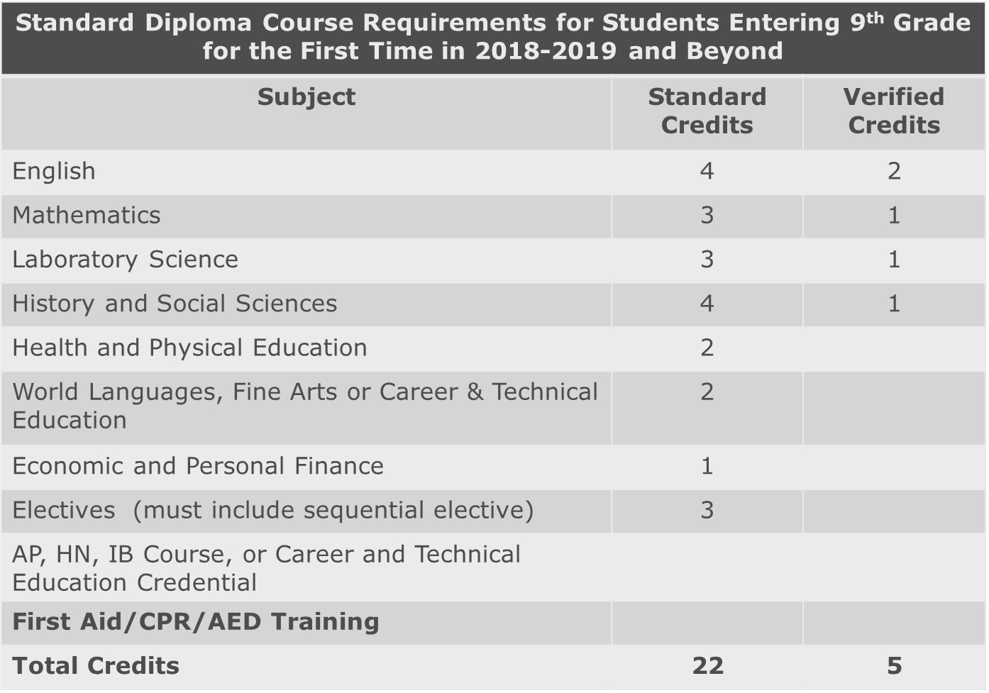
Standard Diploma Requirements
Notes:
All students pursuing a standard diploma must earn 22 standard credits and meet the following requirements:
4 credits of English
3 credits of math
3 credits of science
4 credits of history
2 credits of health and physical education
2 credits of world languages, fine arts or career and technical education
1 credit of economics and personal finance
3 credits of electives (including sequential electives)
Additional Requirements: First Aid/CPR/AED Training; Virtual Course (Economics will count); CTE credential
Students are also required to earn 6 verified credits in the following areas:
English Reading – in Grade 11
English Writing in Grade 11
1 Math (Alg 1, Geom, Alg 2)
1 Science (Bio, Chem, Geosystems)
1 history (WH1, WH2, & US History)
1 student selected verified credit
In addition, students are required to earn a career and technical education credential (industry certification, a state licensure examination, national occupational competency assessment or VA Workplace readiness assessment) First Aid/CPR certification (via HPE 9) and successfully complete one virtual course to satisfy graduation requirements (which is EPF if you take that with FCPS). Fulfilling these requirements will be discussed later in this presentation.

Slide 7
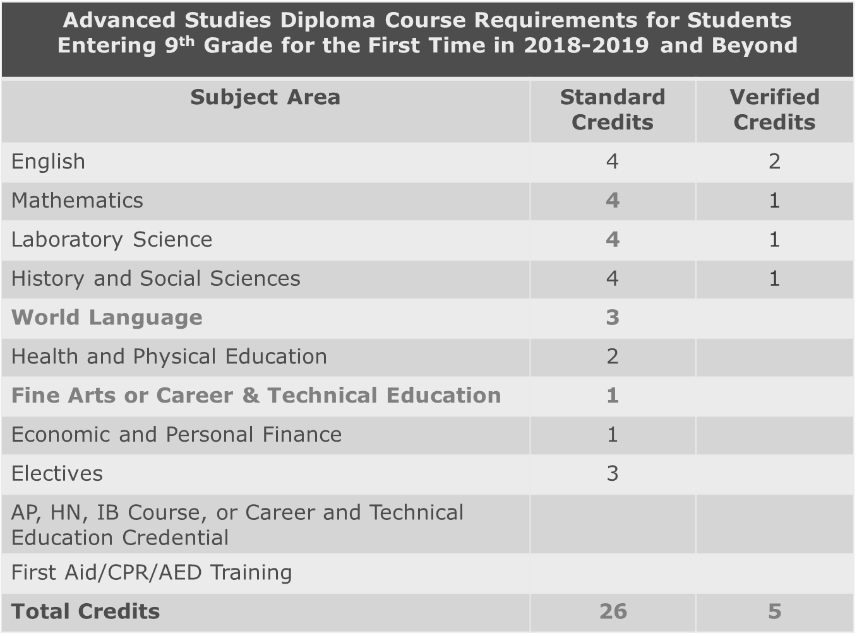
Advanced Studies Diploma Requirements
Notes:
All students pursuing an Advanced Studies diploma must earn 26 standard credits and meet the following requirements:
* The big difference between Advanced & Standard diploma are the amount of Math & Science requirements along with World Language requirements. This is designed to be a little more college prep intensive. Don’t get caught up in the name of the diploma as it appears no where until after graduation. Our philosophy is to start with this goal in mind if necessary due to medical, emotional, social issues we can always go to the standard diploma.
4 credits of English
4 credits of math
4 credits of science
4 credits of history
2 credits of health and physical education
3 credits of world language
1 credit of Fine arts or career and technical education
1 credit of economics and personal finance
3 credits of electives
Students are also required to earn 9 verified credits in the following areas:
English Reading In grade 11
English Writing in grade 11
2 Math (Alg 1, Geom, Alg 2)
2 Science (Bio, Chem, Geosys)
2 history (WH1, WH2, US Hist)
1 student selected verified credit
Additional Requirements: First Aid/CPR/AED Training; Virtual Course

Slide 8
Verified Credit Requirements
Students earn a Verified Credit when they pass an SOL test AND the corresponding course. Students may also earn Verified Credits through VDOE approved assessments.
Courses with end of course SOL tests:
English 11 (2 tests- Reading and Writing)
World History 1, World History 2, US VA History
Algebra 1, Geometry, Algebra 2
Biology, Chemistry, Geosystems
Verified Credit requirements depend on diploma type.
Notes:
As mentioned previously, (Read 1st Bullet)
For information on additional opportunities to earn verified credit, please see your student’s school counselor.
There are 10 courses with associated SOL tests. They are: (Read the sub-bullets of bullet 2)
(Read 3rd bullet)
Will appear on transcript with 1.0 meaning they passed, 0.00 if they failed or were not present.
Sub SOLs if you are in AP courses (AP exam = SOL) could sub SOLS with ACT scores if necessary
Students should take them seriously even if they may not need them for graduation purposes.
Passing score is a 400 or above

Slide 9
Green & Gold Block Schedule
Green Day |  | Gold Day
1st Period | 8:10 – 9:42 a.m. | 2nd Period
3rd Period | 9:49 – 10:37 a.m. | 3rd Period
Saxon Time | 10:37 – 11:11 a.m. | Saxon Time
5th Period (w/lunch) | 11:18 a.m. – 1:18 p.m. | 4th Period (w/lunch)
7th Period | 1:25 – 2:55 p.m. | 6th Period
Notes:
No longer have every class every day!
4 lunches
Classes are not given any particular period…just luck of the computer scheduling
3rd period is daily!
This schedule never changes no matter if we have snow days etc…
TIP: print the entire school year green/gold schedule from the LHS website the day before school starts in color and put on the refrigerator

Slide 10
Saxon Time
Saxon Time is a 30 minute block of time each day after 3rd period reserved for students to:
See a teacher for additional support
Study
Catch up on assignments
If in the Saxon Support program, be assigned a schedule to see teachers for additional support
Participate in Saxon Service, offered twice per month
Notes:
Saxon Time…..
Purpose? Time is built in for remediation, make up work, extra help or a learning break every day
Meeting?
At the beginning of year freshman not allowed in common area in effort to train them to go to classes.
TIP: if your student doesn’t know where to go stay in their first class or go to 3rd period and stay

Slide 11
Typical 9th Grade Schedule
English 9
World History I
Biology
Math
Health/PE 9
World Language
Elective
Notes:
Math: Most likely Algebra 1, Geometry, or Algebra 2
World Language Options: Spanish, French, German, Russian, Latin, Japanese

Slide 12
Honors English 9 & World History 1
Students should…
Love reading
Be able to comprehend multiple chapters of a novel in a night
Be able to handle 1.5 hours of homework per class period
Note: These courses are ‘linked’ for students enrolled in both.
Notes:
Analytical thinkers
Out of the box
Critical thinking skills
Have to like it!!!!

Slide 13
English 9: Standard vs. Honors
English 9 Standard:
“The Scarlet Ibis”
“The Most Dangerous Game”
“The Gift of the Magi”
“The Necklace”
The Odyssey (Excerpts)
The Hound of the Baskervilles
A Long Way Gone
Romeo and Juliet
“The Man in the Water”
English 9 Honors:
The Epic of Gilgamesh
Medea (supplementary)
The Odyssey
The Inferno
A Long Way Gone
Romeo and Juliet
"The Man in the Water“
Poetry
Choice from these titles:
The Secret Life of Bees
The Book of Lost Things
The Curious Incident of the Dog in the Night-Time
Required summer reading: A chapter from Michener’s The Source: “The Bee Eater.”
Notes:
In honors, students write every three weeks; standard students write less frequently, but work through many more drafts than honors students do. Both honors and standard classes average one common-writing assessment per quarter.

Slide 14
Biology Honors
Successful students tend to be…
Highly organized
Strong, independent workers
Good analytical thinkers
Able to handle an Independent Research Project (IRP), worth 10% of the course grade.
Students develop their IRP from January through May, and present to their class at the end of the school year.

Slide 15
Geometry Honors / Algebra II Honors
Successful students tend to…
Have a well developed mathematical vocabulary to be able to study from the text book
Be able to work independently
Be able to make connections and conjectures based on prior knowledge
Teachers guide students through new concepts but do not present 100% of the material in class
Notes:
We Algebra 1 Hon in 5 years due to lack enrollment

Slide 16
Economics & Personal Finance
A graduation REQUIREMENT
Satisfies the Virtual Course requirement for graduation
Students take the W!SE test, which satisfies the CTE credential requirement for graduation
AP Macro/Micro Economics course may be used in place of EPF to satisfy this graduation requirement.
We strongly recommend taking EPF in either 11th or 12th grade

Slide 17
Health and Physical Education
Graduation Requirements: HPE 9 and HPE 10
9th Grade:
3 quarters of PE-
Fitness, Team and individual activities, CPR
1 quarter of Health (Alcohol, Tobacco and Other drugs, Disease prevention, Human Growth and development)
Projects, usually I per quarter
Uniform (purchased through teacher)
Daily physical assessments
10th Grade:
2 quarters of PE –
Fitness, Team and individual activities
Projects, usually I per quarter
1 quarter of Health (Nutrition, Human Growth)
1 quarter of Driver’s Education
Students can only take Dr Ed as a sophomore
Required part of sophomore HPE
9th Grade Elective: Sports Medicine
10th-12th Grade Electives: Sports Medicine, Personal Fitness 1 and 2, Adv. PE Personal Fitness 1 and 2, Adv. PE for Girls

Slide 18
World Languages at Langley
Spanish
French
German (Levels 3&4 only)
Russian
Japanese
Latin
Chinese*
* Marshall Academy

Slide 19
Humanities Electives Open to 9th Graders
Film Study
Forensics/Debate
Journalism 1
World Religions/ Philosophy
AP Human Geography
Current Affairs/ Political Science
Notes:
Film Study is not watching film all day. It actual has lots of writing and analytical skills involved.
If sensitive to religious talk don’t take World Religion (will take you out of comfort zone)
Forensics/Debate (not CSI but a public speaking course
Current Affairs is a lot of discussion at times about controversial topics outside of comfort zones
Electives can be mixed levels therefore not all 9th graders

Slide 20
Performing Arts Electives Open to 9th Graders
Band*
Percussion Ensemble
Jazz Ensemble (8th pd)
Mixed Ensemble
Music Theory
Orchestra*
Choir
* Audition required
Theater Arts 1
Tech Theater 1
Broadcast Journalism
Notes:
Broadcast Journalism creates daily announcements…all students required to be in front of the camera at some point
Band, Orchestra, and Choir usually take at least one optional big trip for performances (this year Indianapolis for Band, Nashville for Orchestra, Hollywood for Choir)

Slide 21
Fine Arts Electives Open to 9th Graders
Studio Art & Design 1
Digital Design 1
Photography 1
Photojournalism 1
Ceramics 1/Sculpture 1
Notes:
Photojournalism = Yearbook
Digital camera for Photography (sometimes with film 35 mm) because learns dark room

Slide 22
CTE: Career & Technology Education Electives
Intro to Marketing
Intro to Marketing - Fashion Emphasis
Programming
Info Systems
Design and Technology
STEM Design
**An Industry Certification Exam is offered with each of these courses.
Notes:
No homework typically
Design Tech & Basic Tech just got a NEW state of the art classroom

Slide 23
Should I Take Honors Classes?
Am I making an A or B+ in the corresponding middle school course?
Am I intellectually curious?
Do I have an interest/passion for the subject?
Do I do my homework on a daily basis without much supervision?
Do I have an out of school schedule that will allow more time to focus on school work?
Love to read (Humanities)
Notes:
YOU NEED TO LIKE the subject
It is about balance There is more than academics in high school
Don’t try to fit into a college but instead find a place that fits who you are (less frustrating)

Slide 24
Should I Take an AP Class?
Expect 1-2 hours of homework per class, and the workload of a college course
Essential Skills:
Critical Thinking
Excellent Reading & Writing Skills
Self-motivated work ethic
Pace of the course – Material presented at an accelerated pace, often with expectation of student learning additional material outside class
Is it better to get an “A” in a standard class or a “B” in an AP or Honors Class class?
Generally, students who can earn a “B” or above in an AP class should consider taking the AP class. A “B” in an AP class amounts to a 4.0 weighted GPA and a stronger schedule.
A “B” in an honors course amounts to a 3.5 weighted GPA with a stronger schedule whereas an “A” in a regular class is a 4.0 GPA.

Slide 25
Honors/AP Classes – Grade Weighting
Honors Classes add an additional GPA weight of .5 to a student’s grade on their transcript. Example – An A in English 9 is worth 4.0 points, whereas an A in English 9 HN is worth 4.5
AP Classes add an additional GPA weight of 1.0 to a student’s grade on their transcript. Example – An A in Film Study is worth 4.0 points, whereas an A in AP Human Geography is worth 5.0
Notes:
Are these the right classes for your student? While you may enjoy the subject, your student is the one who needs to be passionate about that subject and willing to work hard to pursue an honors/AP course.

Slide 26
Questions about appropriate placement for 9th grade?
Talk with your middle school teachers and counselors.
Notes:
LHS does not get student records until the summer Hard to advise without the big picture
If you don’t know start in standard and then move up if appropriate the beginning the school year

Slide 27
High School Counts – Even Now!
Many Class of 2022 students are already earning grades that will appear on their high school transcripts.
Expunging a course and grade.
Retaking a course
Summer School

Slide 28
Keys to High School Success
BALANCE!
Courses which challenge you, but do not overwhelm you.
Getting Involved in Sports/Clubs/Arts/Service. Langley offers so many options!
Healthy Choices: Diet, Sleep, Organization.
Using resources to develop routines and good academic habits.
Program/Resource for Freshmen: Freshman Transition, Langley Link Program

Slide 29
Sports & Clubs
2018-2019 Sports Tryout Dates Activities Fair – April 6, 2018 Fall Sports – July 30, 2018 Winter Sports – November 5, 2018 Spring Sports – February 18, 2019 www.langleysports.org Follow us on Twitter @langleysports
Notes:
Activities Fair – 8th graders coming to Langley

Slide 30
What’s Next…
8th grade students complete a course request form with parents and return it to their middle school counselor
LHS will get all course request forms from middle schools by February 28, 2018
Confirmation of course selections will be mailed home (Date TBA).
Registration of students transferring from private schools begins February 20th.
Freshman Orientation is August 22nd.
See you August 28th – First Day of School!

Slide 31
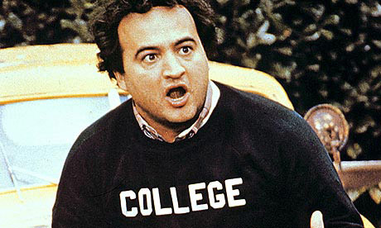
Already Thinking Ahead To…
College?
Notes:
Try to keep the focus on HIGH SCHOOL, and college will follow.

Slide 32
Top Ten Factors Used In Admissions Decisions (NACAC 2014)
Grades in College Prep Courses (Honors & AP)
Grades in All Courses
Strength of Curriculum
Admission Test Scores (SAT and/or ACT)
Essay or Writing Sample
Counselor Recommendation
Applicant’s Demonstrated Interest
Teacher Recommendation(s)
Class Rank (Not applicable for FCPS applicants)
AP Test Scores
Note What Is NOT in Top 10: Extracurricular Activities (12), SAT II Scores (13), Interview (14), Work (16).
Notes:
Note: These are composite results, and may differ from one college to the next.

Slide 33
On Behalf of All of Us at Langley High School
Welcome to
Saxon Country!
Notes:
We are looking forward to meeting and working with your children for the next four years!

