Slide 1
Langley High School Senior Parent Update
Information as of May 7, 2020 5PM

Slide 2
Table of Contents
Slide(s) | Title | Description
3-7 | Knowns – Need Action | Saxon Broadcast Virtual Senior Picnic Video Saxon Scope (Newspaper) – Senior Scope Saxon Shire (Yearbook) FCPS Senior Survey (Transcript to Colleges) Class Parents Senior Video Senior Yard Signs AP Exams
8 | Known Cancellations | See slide
9-10 | Financials | LHS Parking Tag Refund FCPS Meal/Cafeteria Account Refund AP Exam Refund Senior Class Dues Trips and other Cancelled Events ANGP Related Items
11 | Graduation-related Unknowns
12 | Other Unknowns

Slide 3
KNOWNS…
Virtual Class Picnic – Saxon Broadcast Crew
Each Senior creates a 5-15 second video of themselves, filmed horizontally
Say name and plans for next year
Wear college gear
Email all videos to saxonbroadcast@gmail.com by May 8
Saxon Scope - Senior Scope
Will be available on https://www.saxonscope.com/ in early June and in print for Seniors
Deadline to submit Senior plans for next year is May 13
Seniors use FCPS Google login and submit plans with this form: https://forms.gle/zTm9HjJzHij1eiet9
Stay tuned for how Seniors will cast their votes for Senior Superlatives
Yearbook will be published - a MUST HAVE for the Class of 2020
Deadline to order is June 1st (while supplies last, 275 copies remain)
Use Langley’s school code 4159: https://www.yearbookordercenter.com/
You can also confirm that you placed an order at https://www.yearbookordercenter.com/
Yearbook staff is committed to distributing to all Seniors, exact details TBD

Slide 4
KNOWNS…
FCPS Senior Survey due May 22
REQUIRED, mechanism for sending transcripts to the correct school
Confidential, not shared publicly
Data used by LHS, FCPS, and Commonwealth of Virginia
Hannah Wolff has sent multiple emails to Seniors and Parents with detailed instructions, survey link, etc.
Questions: hwwolff@fcps.edu
Senior Video
Deadline to submit pictures is Monday, May 18th at midnight
We are asking every family (who has not already submitted pictures) to email their 5 favorite pictures of their senior + other seniors participating in a Langley activity, ideally 1 picture for each year
Will be posted on YouTube
Email pictures to lhs2020photos@gmail.com
As of 5/7/20: we do not have ANY pictures for the following activities:
theatre/drama
choir
soccer
baseball
softball
lacrosse
crew
swim/dive

Slide 5
KNOWNS…
Senior Yard Signs
Personalize and pay for your sign online: https://www.ptsalangley.org/angp-yard-sign
Deadline for new orders is May 31st
ANGP Committee will distribute original orders (placed prior to April 30th) the week of May 11th (exact details TBD)
Questions: klervick@yahoo.com (Kari Lervick)

Slide 6
KNOWNS…
AP Exams (https://apcoronavirusupdates.collegeboard.org/students)
Will be held on-line only May 11-22: https://apcoronavirusupdates.collegeboard.org/students/taking-ap-exams/ap-exam-schedule
College Board Online AP Classes and Review Sessions: https://apcoronavirusupdates.collegeboard.org/students/ap-course-schedule
FCPS Information, including refunds, accommodations, etc.: https://www.fcps.edu/news/coronavirus-update-faqs#ap
FCPS latest press release (updated May 5) https://www.fcps.edu/news/fcps-shares-new-updates-ap-and-ib-students
The College Board has repeatedly emailed each AP student relevant AP testing information; therefore, it is important that students check the email associated with their College Board account. If a student has not received this email, they should contact their school’s AP Testing Coordinator or AP teacher(s). Students will be able to take online AP exams with College Board approved accommodations such as extended time automatically. If your Senior does not want to take the exam, no action needed other than NOT taking the exam. AP exam fee refunds – see Financials slide for more details.
NOTE: It is critical that Seniors use personal email and NOT their FCPS email for College Board.

Slide 7
KNOWNS…
Last Day of School for Seniors is May 28
The following Graduation-related items have been ordered for all Seniors
Caps
Gowns
Tassels
Diploma covers
Service Learning Cords (for those who qualify by 5/8/20)
Honor Society Cords (for those who qualify)
Senior Awards
Langley is actively organizing and preparing for Senior Awards
Seniors will be recognized for their outstanding accomplishments
TBD on best way to share recognition and distribute awards

Slide 8
KNOWN CANCELLATIONS…
Senior Ethics Day
Langley Leap
Blood Drive at Langley
Seniors encouraged to donate https://www.inovablood.org/
Junior/Senior Prom
Senior Class Field Trip to Hershey Park
Baccalaureate

Slide 9
FINANCIALS…
Each Organization (FCPS, LHS, PTSA, Boosters, etc.)
Is working with vendors to secure refunds for deposits
Is determining if event could happen at a future date
Is evaluating refund mechanism
Will notify you directly with options or refund
Event/Item | Responsible Organization | Status
LHS Parking Tag | FCPS | $50 will be refunded. Check or MSB and Date TBD No action needed
Meal Payments (via MSB) (Transfer to remaining child in FCPS or request refund) | FCPS | Action Required: https://www.fcps.edu/resources/student-safety-and-wellness/food-and-nutrition-programs/prices-lunch-account-prepayments
AP Exams | FCPS | Students with AP exam counts over six FCPS-funded exams, who have paid the $94 AP exam fee and choose NOT to take their AP exam will be refunded the fees in June. No action required (except to not login to take the exam). https://www.fcps.edu/news/coronavirus-update-faqs#ap

Slide 10
FINANCIALS…
Event/Item | Responsible Organization | Status
Senior Class Dues | LHS | No refunds as of now, pending graduation related event planning. TBD
Spring Break Trips (e.g., Baseball, Russia, etc) | Booster Organizations, Others | Entity to whom you wrote check/sent funds is contact for refunds.
Other Trips | Booster Organizations, Travel Agencies, LHS, Others | Entity to whom you wrote check/sent funds is contact for refunds.
ANGP | LHS PTSA | No refunds as of now, pending graduation related event planning and securing deposit refunds. TBD
NOTE: Several emails re: Prom refunds? Tickets were never sold for Prom, so nothing to refund.

Slide 11
UNKNOWNS…
Graduation – Related Events
Senior Family Breakfast
Senior Awards Ceremony (Exactly how/when is TBD)
Graduation Ceremony
All Night Grad Party (ANGP)
From Elaine Tholen, Dranesville District School Board Representative
“It is my understanding that each school will be able to plan a meaningful Graduation ceremony for their Seniors.
My fellow Board members and I think it is very important for each Senior to receive all of the items they would have normally received such as cap, gown, tassel, cords, etc.”

Slide 12
UNKNOWNS…
Return of School Property (laptops, books, etc)
Retrieval of Student Property on School Grounds (may be required to fulfill obligations)
Student Obligations
What about Seniors who have not yet paid mandatory class dues
Senior Class money uses/distributions
George Mason Dual Enrollment Grading, Exams, College Credit
Student Services Senior Program: HAZE, Perils of College Drinking
Senior Picnic

Slide 13
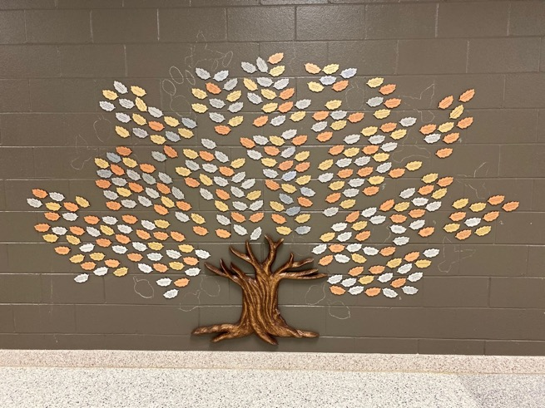
Langley PTSA Courtyard Fundraiser
Donate:
https://www.jotformpro.com/90294874131156
Questions: chrissielavin1@gmail.com

Slide 14
Appendix

Slide 15
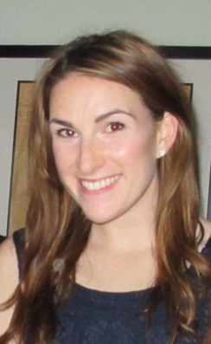
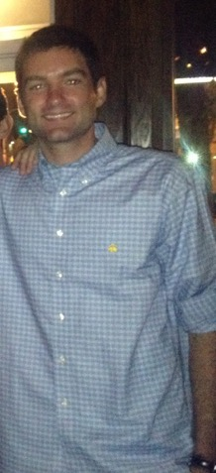
Class of 2020 Faculty Sponsors
Class of 2020 Administrator
Jim Robertson
jim.robertson@fcps.edu
Mary Baker, English Dept.
mdbaker@fcps.edu
Jeffrey Vande Sande, History Dept.
jtvandesande@fcps.edu

Slide 16
LHS2020 Class Officers
President: Robert Hage
Vice President: Kavye Vij
Secretary: Babak Changiz
Treasurer: Ishaan Kathuria
SGA Rep: Alexis Bailin
Stephanie Derminassian
Megan Markwart

Slide 17
Class of 2020, Class Parents
Class Website: http://www.ptsalangley.org/class-of-2020
Lead Class Parent: Elizabeth Trumbull, elizabeth.trumbull@gmail.com
Treasurer: Susan Connery, susangconnery@gmail.com
Communications: Annette Bellino, annette.bellino@verizon.net
Dinners+: Sarah Tyler and Jenifer Lesan, sarah.t.tyler@gmail.com, jrlesan@gmail.com
Volunteers: Julie Assaad, jassaad01@gmail.com
Senior Slideshow: Jane Riddle, jriddle13998@gmail.com
2019 Prom: Christina Treacy and Lisa Nevins, christina_treacy@hotmail.com, lisanevins@verizon.net
2020 ANGP: Missy Perkins, missyperkins72@gmail.com
ANGP Website: https://www.ptsalangley.org/angp

Slide 18
Counselors
Student’s Last Name | Counselor
A-Chang | Michael Johnson msjohnson@fcps.edu 703-287-2731
Chap - Gan | Alex Mantel armantel@fcps.edu 703-287-2733
Gao – Jua | Natalie Malone nlmalone@fcps.edu 703-287-2732
Jub – Matu | Timothy Ready tjready@fcps.edu 703-287-2730
Matz – Pride | Jennifer Baldesare jlbaldesare@fcps.edu 703-287-2734
Prin – Sun | Katie Robinson kerobinson1@fcps.edu 703-287-2736
Suo - Z | Nichole Bernard nbernard@fcps.edu 703-287-2735
Additional Student Services Staff
https://langleyhs.fcps.edu/department/student-services-staff

Slide 19
Class of 2020--Important Links
Description | Link
SIS ParentVUE Login | https://sisparent.fcps.edu
SIS ParentVUE Registration | https://www.fcps.edu/resources/technology/student-information-system-sis-fcps/sis-parent-account-registration
Blackboard, weCare, Naviance for Families | https://fcps.blackboard.com/
FCPS News | https://public.govdelivery.com/accounts/VAEDUFCPS/subscriber/new
LHS Website | http://www2.fcps.edu/LangleyHS/
LHS Class of 2020 Webpage | http://www.ptsalangley.org/class-of-2020
ANGP2020 Webpage | https://www.ptsalangley.org/angp
LHS PTSA Website | http://www.ptsalangley.org/
LHS PTSA Key Links | http://www.ptsalangley.org/lhs-quick-links
LHS Activities Website | http://www.langleysports.org/
LHS Service Learning | http://www2.fcps.edu/LangleyHS/servicelearning.html

