Slide 1
Langley High School Senior Parent Forum
Remote attendees:
https://us.bbcollab.com/guest/9b21ebbfd62f4480aed7e5fb15abe8bf
Text Questions to Susan Connery: (202) 390-7703
February 4, 2020 9:30-11AM

Slide 2
Agenda
Time | Speaker | Description
9:30 | Elizabeth Trumbull Betsy Shomaker | Welcome Mid-year transcripts, Service Cord
9:45 | Hannah Wolff | Now what…
10:15 | Elizabeth Trumbull | What to do NOW to prepare for Life after Langley
10:25 | Jim Robertson Susan Connery Missy Perkins Jane Riddle Laura Skeen | Senior Updates Student Obligations ANGP Senior Video PTSA Legacy Tree
10:45 | Elizabeth Trumbull | Senior Calendar Review Q&A
11:00 | Adjourn

Slide 3
College and Career Center Specialist
Hannah Wolff
https://langleyhs.fcps.edu/student-services/college-and-career-center
NPR Terry Gross Link (College Student Mental Health)
https://www.amazon.com/Stressed-Years-Their-Lives-Helping/dp/125011313X/ref=asc_df_125011313X/

Slide 4
National School Counseling Week (Feb 3-7)
Student’s Last Name | Counselor
A-Chang | Michael Johnson msjohnson@fcps.edu 703-287-2731
Chap - Gan | Alex Mantel armantel@fcps.edu 703-287-2733
Gao – Jua | Natalie Malone nlmalone@fcps.edu 703-287-2732
Jub – Matu | Timothy Ready tjready@fcps.edu 703-287-2730
Matz – Pride | Jennifer Baldesare jlbaldesare@fcps.edu 703-287-2734
Prin – Sun | Katie Robinson kerobinson1@fcps.edu 703-287-2736
Suo - Z | Nichole Bernard nbernard@fcps.edu 703-287-2735
Additional Student Services Staff
https://langleyhs.fcps.edu/department/student-services-staff

Slide 5
What to do NOW….
Your senior needs to learn to solve problems on their own
Stop texting your senior hourly/daily/whenever they change locations (and do not expect them to text you)
Encourage them to try new things, join something new
If your student needs academic accommodations, transition that to their responsibility as much as possible (guide, don’t execute)
Encourage your students to engage with teachers/adults at Langley.
Encourage getting help early, not when too late
Encourage them to schedule their downtime
Encourage them to be open to new things – become closer friends with someone they didn’t normally hang out with at Langley
Hold them accountable
Normalize failure

Slide 6
What to do NOW….
Area | Top Items | Reference
Financial | Checking Account Savings Account Debit Card Credit Card College Expenses Transportation Expenses UMTA & 529 Accounts Create a Budget | https://www.nerdwallet.com/blog/finance/budgeting-for-college-students/ https://www.affordablecollegesonline.org/college-resource-center/student-guide-to-budgeting/ https://www.cnbc.com/2019/08/28/5-things-every-college-student-should-do-with-their-money.html https://promo.bankofamerica.com/checkingforstudents/
Legal | HIPAA Authorization Healthcare Power of Attorney General Durable Power of Attorney College-Specific Items (FERPA: Financial, Grades, Attendance, Discipline, Health, etc.) | https://www.natlawreview.com/article/three-critical-legal-documents-every-parent-college-student-should-get-place-soon https://clark.com/health-health-care/college-students-legal-documents-hipaa-power-attorney/ https://www.kiplinger.com/article/college/T065-C001-S001-legal-documents-for-college-students.html https://www2.ed.gov/policy/gen/guid/fpco/pdf/ferpafaq.pdf

Slide 7
What to do NOW….
Area | Top Items | Reference
Household | Laundry Schedule (Sleep, Activities, Meals, Family, Church, etc.) Curfew Financial (allowance, food, gas, insurance, etc.) Job Driving in non-ideal conditions Amazon Prime | https://www.collegeraptor.com/find-colleges/articles/tips-tools-advice/30-must-haves-for-surviving-college/ https://www.businessinsider.com/useful-college-dorm-essentials-packing-list-2018-8#a-power-strip-for-all-of-your-devices-16
Travel | General awareness To/from college Drive vs Fly vs Train Riding with others, if no car Public transportation Rental options Visiting friends | https://www.supermoney.com/need-ride-cheap-transportation-college-students/ https://www.collegeraptor.com/find-colleges/articles/student-life/alternatives-car-campus/

Slide 8
What to do NOW….
Area | Top Items | Reference
Medical/ Illness | Insurance Card(s) Primary Care Physician College Healthcare options Regular medicine refills Medical History (how to fill out forms +) Drug Interactions (MyRXprofile and others) Over the Counter medicines and when to use | https://www.myrxprofile.com/

Slide 9
Now that they are 18, they can…
Vote: All LHS Seniors should be registered. They can vote in Primary if will be 18 by General Election.
Join the Military
Register for Selective Service (mandatory for males)
Buy a lottery ticket
Have an alcoholic drink in most places outside the US
Get a body piercing or tattoo without parental consent
Buy a pet
Sign a contract
Change their name
Open a brokerage account and buy a stock
Use a meat/deli slicer at a grocery store job
Book a hotel room
(continued…)

Slide 10
Now that they are 18, they can…
Become a realtor
Become a notary public
Enter and adults-only store
Skydive
Give consent for their own vaccines
Work in a bar and serve alcohol
Sign themselves out of high school
Be called for jury duty
Open a bank account
Have sex legally with someone over 18
Get married without parent permission
Get a 10 year passport
(continued…)

Slide 11
Now that they are 18, they can…
Get a Costco card
Buy real estate or apply for a mortgage
Apply to find their biological parents, if they were adopted
Drive a taxi
Get a license to drive a truck
Be the only person home when a service repair person needs to enter the home
Go the ER alone and get treatment
Work full time in the school year
Register to give blood or be an organ donor
Apply for credit cards
File a lawsuit
Adopt a child
(continued…)

Slide 12
Now that they are 18, they can…
Create a will
Buy a car
Rent an apartment
Buy pornography
Pawn your belongings
Buy spray paint
Bet on a horse race
Buy cough suppressants
Rent Airbnb
Consent to their own medical care
Move out of their parents’ home
Use ride-sharing scooter (Bird, Lime, etc)

Slide 13
Class of 2020, Class Parents
Class Website: http://www.ptsalangley.org/class-of-2020
Lead Class Parent: Elizabeth Trumbull, elizabeth.trumbull@gmail.com
Treasurer: Susan Connery, susangconnery@gmail.com
Communications: Annette Bellino, annette.bellino@verizon.net
Dinners+: Sarah Tyler and Jenifer Lesan, sarah.t.tyler@gmail.com, jrlesan@gmail.com
Volunteers: Julie Assaad, jassaad01@gmail.com
Senior Slideshow: Jane Riddle, jriddle13998@gmail.com
2019 Prom: Christina Treacy and Lisa Nevins, christina_treacy@hotmail.com, lisanevins@verizon.net
2020 ANGP: Missy Perkins, missyperkins72@gmail.com
ANGP Website: https://www.ptsalangley.org/angp

Slide 14
Class of 2020 Administrator
Jim Robertson

Slide 15
Student Obligations
(including Class Dues)
Susan Connery

Slide 16
All Night Grad Party (ANGP) Chair
Missy Perkins
https://www.ptsalangley.org/angp

Slide 17
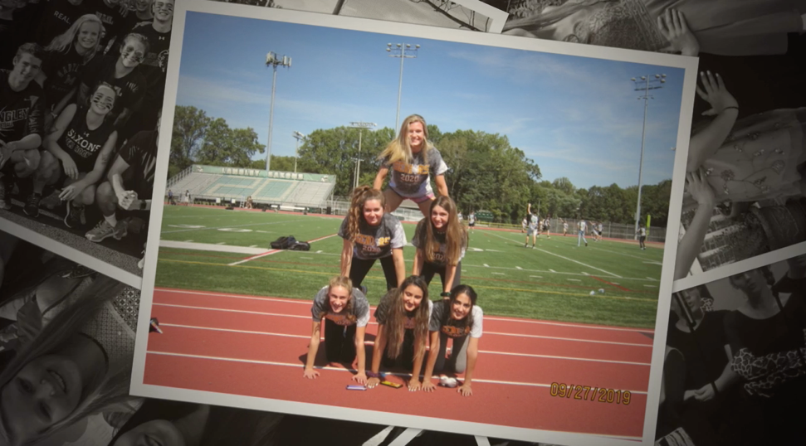
Senior Class Video
Jane Riddle

Slide 18
Class of 2020 Pictures from Freshman, Sophomore, Junior, and Senior Years
Only pictures of the Class of 2020 Only Langley High School events
Email to lhs2020photos@gmail.com
Subject Line of the email- Name of the event and Date of the event (i.e. Spring Concert May 1, 2018)
Tag @lhs2020photos in Instagram posts
Photos
JPEG format
Please send us your BEST SHOT (not all 30)
Video
Quick Time format
20-30 seconds in length

Slide 19
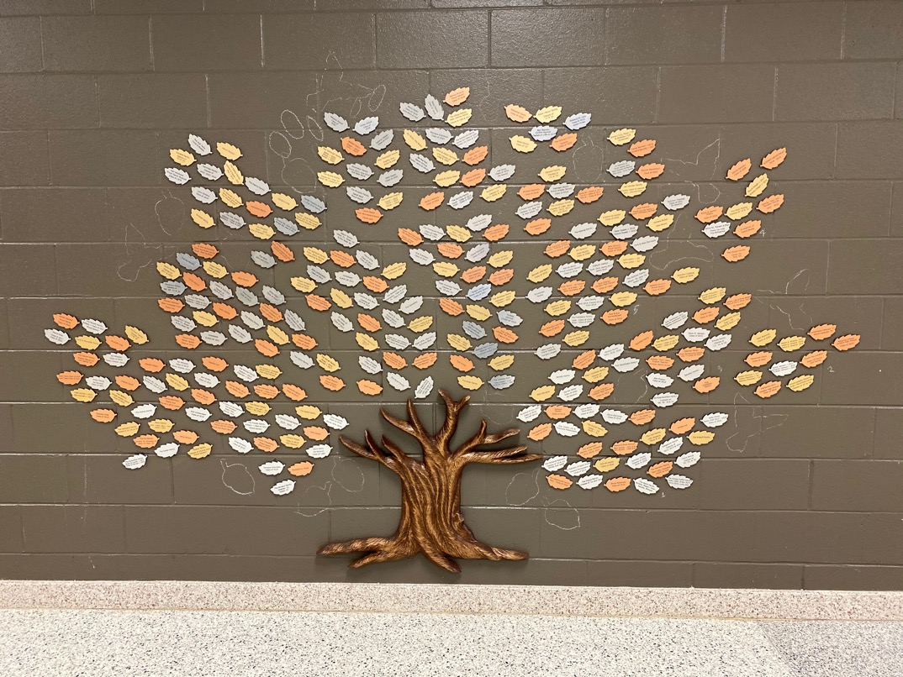
PTSA President – Legacy Tree
Donate:
https://www.jotformpro.com/90294874131156
Laura Skeen

Slide 20
LHS2020 Baccalaureate
Night of reflection for seniors and their families and friends
Non-denominational
All seniors will be recognized during this ceremonial event that will feature performances and shared sentiments offered by our graduating seniors and potentially a guest speaker.
All seniors are encouraged to participate -- either individually or as part of a group -- with readings, personal reflections, poetry, instrumental and vocal performances, and dance.
Parent Co-Chairs:
Kathy Viola and Dana de Kanter
Recruiting Student Co-Chairs NOW

Slide 21
Senior Calendar Detailed Review
Senior Calendar (Updated Feb 1, 2020)
(will download Word document)

Slide 22
Langley Leap - Important Dates
Suggested Deadline for Securing Leap Sponsor Friday, February 28
Application Packet Due to Government Teachers Friday, March 27
Completed Grade Verification Sheets Due to Government Teachers Friday, April 17 (NOTE: Need teacher signatures, use entire week to gather)
Student Obligations Payments Due to participate in Langley Leap Monday, May 11
Langley Leap Monday, May 18 – 22
Completed Attendance Form Due to Government Teachers Wednesday, May 27
Langley Leap Application Packet
(will download Word document)

Slide 23
Class of 2020--Important Dates
ANGP Fundraiser – Capitol Steps @ Langley Auditorium Sunday, February 23, 7PM
Senior Ethics Day @ McLean Bible Church Tuesday, March 17
Langley Leap Application Packet Due to Government Teachers Friday, March 27
Spring Break (Great time to visit colleges with classes in session) April 6 - 13
Senior Parent Forum Thursday, April 23, 9:30-11AM
Senior Picnic and College Picture Day Friday, May 1
AP Exams (May 4-15) https://apcentral.collegeboard.org/courses/exam-dates-and-fees
Prom Saturday, May 16
Come to at least one event: music, sports, clubs, etc.– check your options on the Langley and Langley Sports calendars

Slide 24
Class of 2020--Important Dates
Langley Leap Monday, May 18 – 22
Mandatory Graduation Rehearsal #1 TBD (Likely Wednesday, May 27)
Senior Class Field Trip Thursday, May 28
LHS2020 Senior Family Breakfast, Video, Awards Friday, May 29 8:30AM
Mandatory Graduation Rehearsal #2, Graduation Ticket Distribution Friday, May 29 ~10:30AM
LHS2020 Baccalaureate Sunday, May 31 5PM
LHS2020 Graduation Monday, June 1 10AM
LHS2020 All Night Grad Party (ANGP): Senior Parents Work Event Monday - Tuesday, June 1st-2nd
Come to at least one event: music, sports, clubs, etc.– check your options on the Langley and Langley Sports calendars

Slide 25
Class of 2020--Important Links
Description | Link
SIS ParentVUE Login | https://sisparent.fcps.edu
SIS ParentVUE Registration | https://www.fcps.edu/resources/technology/student-information-system-sis-fcps/sis-parent-account-registration
Blackboard, weCare, Naviance for Families | https://fcps.blackboard.com/
FCPS News | https://public.govdelivery.com/accounts/VAEDUFCPS/subscriber/new
LHS Website | http://www2.fcps.edu/LangleyHS/
LHS Class of 2020 Webpage | http://www.ptsalangley.org/class-of-2020
ANGP2020 Webpage | https://www.ptsalangley.org/angp
LHS PTSA Website | http://www.ptsalangley.org/
LHS PTSA Key Links | http://www.ptsalangley.org/lhs-quick-links
LHS Activities Website | http://www.langleysports.org/
LHS Service Learning | http://www2.fcps.edu/LangleyHS/servicelearning.html

Slide 26
From October Senior Parent Forum – included here for reference, also on Class Webpage
Langley Leap Coordinator
Ryan Jackson
rnjackson@fcps.edu

Slide 27
Langley Leap - Important Dates
Suggested Deadline for Securing Leap Sponsor Friday, February 28
Application Packet Due to Government Teachers Friday, March 27
Completed Grade Verification Sheets Due to Government Teachers Friday, April 17 (NOTE: Need teacher signatures, use entire week to gather)
Student Obligations Payments Due to participate in Langley Leap Monday, May 11
Langley Leap Monday, May 18 – 22
Completed Attendance Form Due to Government Teachers Wednesday, May 27

Slide 28
Langley Leap May 18th – May 22nd, 2020
Students will spend 35 total hours at their internship (7 hrs/day)
Selection of Students: A senior is eligible for the Langley Leap Senior Internship Experience if they meet ALL the following criteria:
A 2.75 cumulative GPA at 7th semester.
Students must have a C or higher as a cumulative grade in each class (including online classes) at the end of the third quarter, and must maintain this grade of C or higher through 4th quarter in each class until Leap begins. Multiple grade verifications will be required to be/remain eligible to Leap.
(continued…)

Slide 29
Langley Leap Requirements (cont’d)
No more than three (3) excused absences during the third quarter and no more than three (3) excused absences during the fourth quarter until the internship starts, excluding school-related activities and two (2) days allotted for college visits. Any unexcused absences may disqualify a student from participating in Leap
Teachers’ signatures and the senior class administrator’s signature to show that student is in good standing – and maintains good standing – regarding attendance, discipline, and grades
Completes all components of the Langley Leap Application Packet (available starting January 6, 2020) by the deadline Friday, March 20, 2020
Attends Ethics Day Forum on Tuesday, March 17, 2020
Pays / rectifies all existing obligations by Monday, May 11, 2020 (one week before Leap starts)
(continued…)

Slide 30
Langley Leap Requirements (cont’d)
Performing Arts Policy: If you are enrolled in a choir, orchestra, band, or theatre course this year and plan to participate in Langley Leap, note that all rehearsals and performances are mandatory. These include class period rehearsals, afterschool rehearsals and dress rehearsals as scheduled per class.
AP/SOL Exam Policy: If you must take a late/rescheduled AP exam or SOL exam required for graduation during the week of May 18-22, you will be required to miss your internship and return to Langley to take the exam. Adjustments will be made in the required internship hours as necessary.
Grading: Students will complete classes by the time the internships start. A student’s final grade for each class will be the determined by the grades achieved up to the start of the internship. Langley Leap seniors will be exempt from taking final exams (except online or dual-enrollment classes)
(continued…)

Slide 31
Langley Leap Requirements (cont’d)
Senior Government teachers will facilitate dissemination and collection of Leap Packets starting in January.
Students enrolled in online Government will receive electronic packets from, and submit all Leap paperwork to the Leap Coordinator, Mr. Ryan Jackson.
Questions? Email me: rnjackson@fcps.edu

