Slide 1
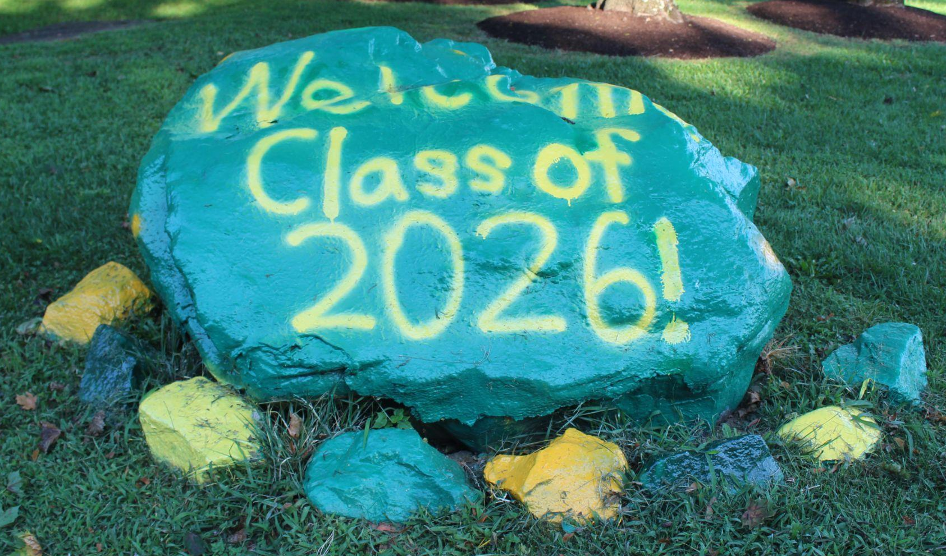
Class of 2026 Parent Coffee
Friday, April 28, 2023

Slide 2
Agenda
Welcome & Introductions
Guest Speaker: Kelly Rankin, LCSW, CSAC, Substance Abuse Prevention Specialist
Parent Volunteers Needed
Keep in Touch
Coming Up Next…

Slide 3
Kelly Rankin,
LCSW, CSAC, Substance Abuse Prevention Specialist

Slide 4
Substance Abuse Prevention Specialists (SAPS)
Each school pyramid has a Substance Abuse Prevention Specialist (SAPS) assigned to provide substance abuse prevention, education, and intervention services. Substance Abuse Prevention Specialists are part of the FCPS Office of Student Safety and Wellness.
Key roles of a Substance Abuse Prevention Specialist:
Alcohol, Tobacco, and Other Drug (ATOD) education for students, parents, and the Fairfax County Community.
Intervention services upon violation of the Student Rights and Responsibilities (SR&R) or suspected substance abuse involvement.
Assessing a student’s level of substance use and, if appropriate, making referrals to Fairfax Community Service Board for additional services.
Group and individual prevention services for students, staff, parents, and the Fairfax County community.
Most importantly, building positive relationships with students to provide support and encouragement!
Notes:
Who are we and what do we do?

Slide 5
Objectives:
Learn about
Identify
Identify
Learn
Learn about teen drug use trends
Identify drug paraphernalia/drug culture
Identify signs of drug use in your child
Learn strategies for prevention

Slide 6
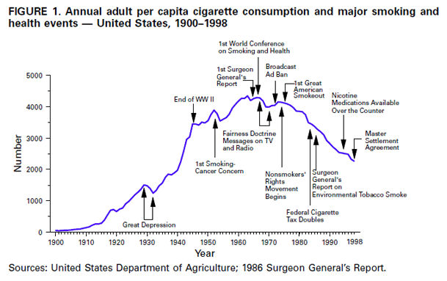
The Rise of the Tobacco Industry
tobaccopreventiontoolkit.stanford.edu
Cigarette use among teens declined. The teen of the 90’s and early 2000’s are today adults that don’t smoke.
Image Credit: vox.com, www.cdc.gov
Notes:
Teacher Talking Points:
As tobacco became more common across the globe, new technology made cigarette production easier.
In the 1880s a cigarette making machine was invented, allowing the tobacco industry to begin and grow (left).
As production increased, so did consumption of cigarettes. In the U.S., cigarette use often fluctuated during major national events (right).

Slide 7
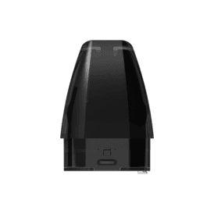
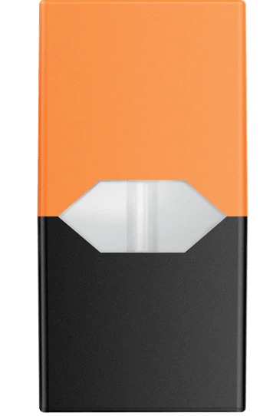
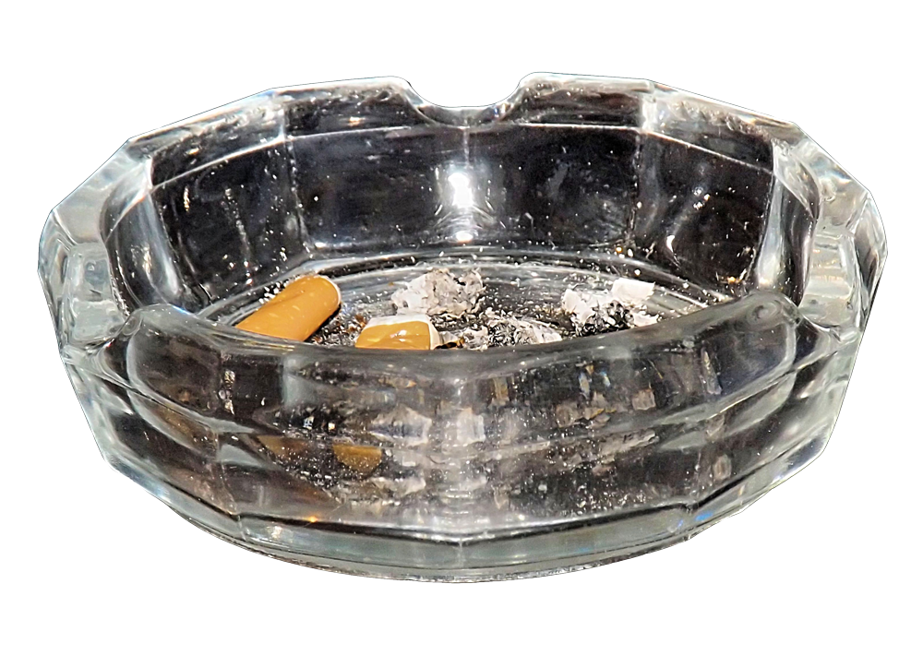
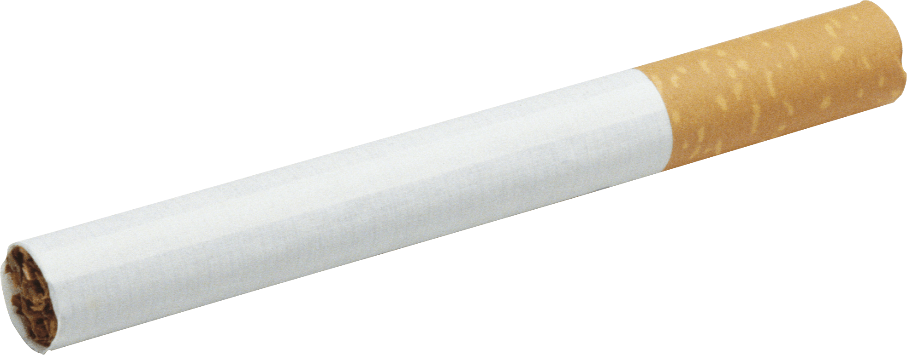
Cigs in a Pod
tobaccopreventiontoolkit.stanford.edu
1 Pack of Cigarettes
≈20 mg of nicotine
1 JUUL pod
≈41.3 mg of nicotine
1 Puff bar
≈50 mg of nicotine
1 Suorin pod
≈90 mg of nicotine
ALL PODS CONTAIN HIGH LEVELS OF NICOTINE
=20
CIGARETTES
≈41
CIGARETTES
≈50
CIGARETTES
≈90
CIGARETTES
Notes:
Teacher Talking Points:
If you don’t know, a standard pack of cigarettes contains 20 cigarettes (click). There is 1 mg of nicotine absorption per cigarette, so about 20 milligrams of nicotine delivered to the body from a whole pack of cigarettes.
Unlike other e-juices which may or may not contain nicotine, ALL salt-based e-juice contains nicotine!
According to JUUL Labs, one JUUL pod contains 41.3 milligrams of nicotine. This is equal to the amount of nicotine you’ll find in about 40 cigarettes (click).
How many packs of cigarettes would a JUUL pod then be equal to? Answer: about 2 packs
As mentioned before, this is a high amount of nicotine and can be intense for first-time users. Our concern is that young people are being introduced to a high amount of nicotine, developing a tolerance quickly, and becoming addicted as a result.
1 Puff bar contains 50 milligrams of nicotine (click), which is equivalent to 50 cigarettes. How many packs of cigarettes would a Puff bar then be equal to? Answer: about 2 ½ packs
1 Suorin Vagon cartridge contains up to 90 milligrams of nicotine or 90 cigarettes (click). How many packs of cigarettes would a Suorin pod then be equal to? Answer: about 4 and a half packs
(Click) No matter what pod device you are using, all of them contain high levels of nicotine which is extremely addictive, which keeps you coming back for more.
PLEASE SEE BELOW FOR A THOROUGH BREAKDOWN: ​
​
For the nicotine levels in these pod-based products, we looked at the amounts in milligrams per milliliter and/or percentage of nicotine by weight reported by these pod-based companies. Here is a stoichiometry breakdown:​
​
One JUUL pod is reported to contain 59 mg/mL (https://support.juul.com/home/learn/faqs/juulpod-basics), but one JUUL pod is only 0.7mL per pod. ​
​
[59 mg/mL] x [0.7mL] equals 41.3mg (NOTE: milliliter units cancel out)​
​
The makers of Puff bar report there being 50 milligrams of nicotine per Puff bar (​https://puffecig.com/puff-bar-disposable-device/).
​​
The Suorin Vagon cartridge/pod can hold an e-juice volume of 2mL (https://www.suorinusa.com/collections/suorin-vagon/products/suorin-vagon?variant=8436760281141). Suorin devices are semi-closed systems meaning that they are not pre-loaded like PHIX and JUUL, but Suorin still sells salt-based nicotine with nicotine by weight close to what JUUL and PHIX have. In their case, it is 4.5% (https://www.suorinusa.com/collections/blowsauce-salted/products/blowsauce-watermelon-lollipop-e-juice-by-dripfire-30ml-salted-edtion?variant=1053863936026).​
​
We used a simple conversion of 45mg/mL to represent the 4.5% nicotine by weight, so [45mg/mL] x [2mL] equals 90mg.​
​
We decided to use 41.3mg since it is the true amount of nicotine in one pod. One JUUL pod is equivalent to smoking anywhere from 26 to 40 cigarettes, which is more than 1 pack of cigarettes (20 cigarettes). This range depends on whether there is an uptake of 1mg or 1.5mg of nicotine per cigarette, for someone using. We decided on 1mg since it captures the maximum potential of nicotine uptake for these pod-based devices. ​
​
References: ​
https://www.ncbi.nlm.nih.gov/pubmed/6705448 ​
https://www.ncbi.nlm.nih.gov/pubmed/11208883​
https://www.drugabuse.gov/publications/research-reports/tobacco-nicotine-e-cigarettes/how-does-tobacco-deliver-its-effects
​
Images:​
Ashtray - https://www.actaturcica.com/2018/05/09/ashtray-png-transparent-image/​
Cigarette - https://www.istockphoto.com/ae/photos/package-of-cigarettes?excludenudity=true&mediatype=photography&phrase=package%20of%20cigarettes&sort=mostpopular​
JUUL pod - https://www.juul.com/shop/pods/mango-5-percent​
Puff bar - https://www.ievapor.com/puff-bar-menthol-disposable-pod-device-10pcspack-p-1930.html
Suorin pod - http://yetivape.com/suorin-vagon-pod/ ​

Slide 8
Timeline to Nicotine Addiction
Tries in 6, 7th, 8th grade
“I didn’t own one”
Eventually owns one
How? Older adult, easy to purchase online
Parents/guardian give cash for food. Student get visa gift card.
Easy to hide use
Use begins more often, at home
Summertime use increases
Addicted by 9th or 10th grade

Slide 9
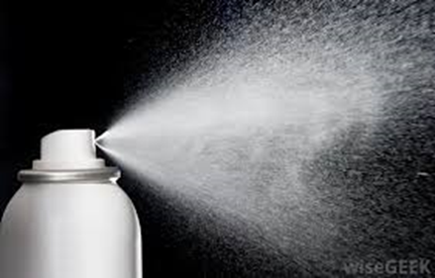
Did You Know: You are not inhaling a vapor; you are inhaling an aerosol. Do you know the difference?
Vapor
Aerosol
Center for Disease Control

Slide 11
What happens after you hit a vape?
E-liquids, almost always include nicotine, flavoring and a solution, such as propylene glycol, Diacetyl and create the aerosol when heated.
While many of the flavorings and chemicals used in e-liquids have been approved by the Food and Drug Administration for oral consumption, they have not been approved for inhalation.
Once inhaled the aerosol cools down it dissolves in an oily liquid base deep in your lungs that could cause inflammation.
John Hopkins Medicine

Slide 12
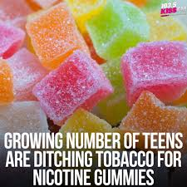
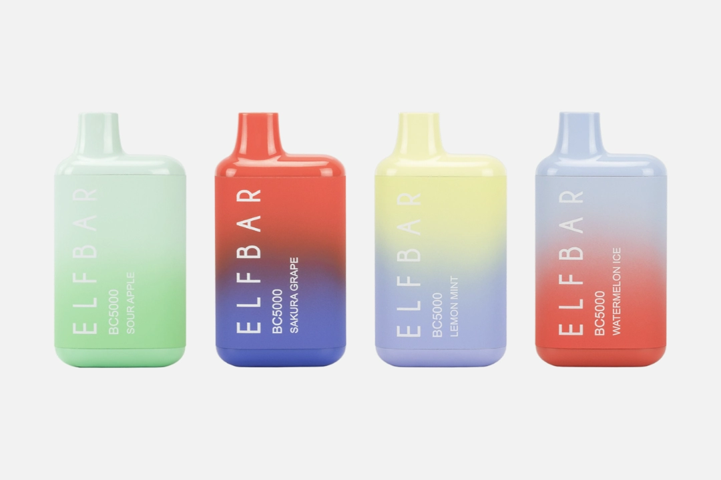
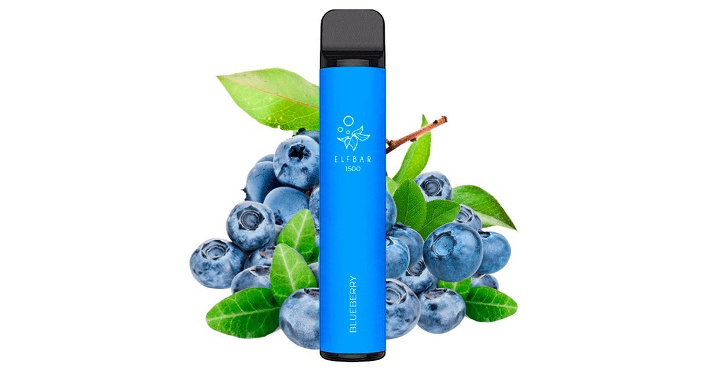
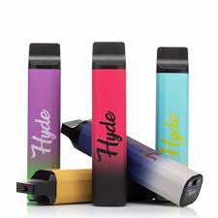
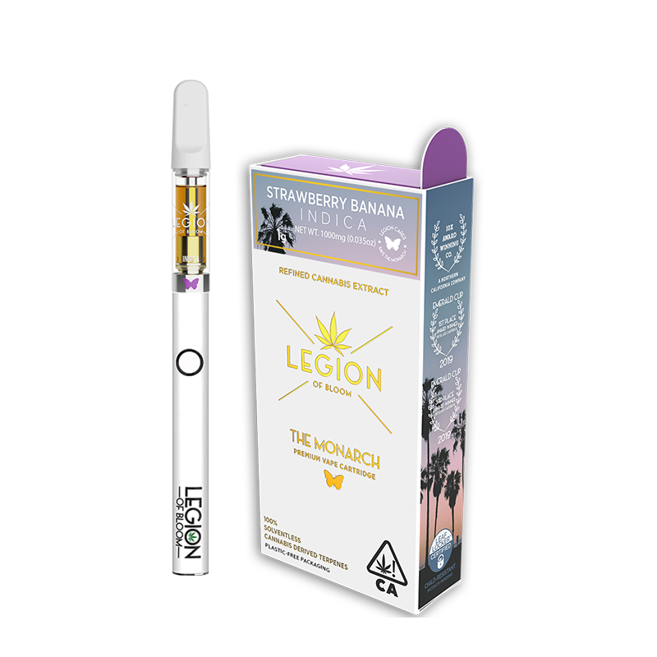
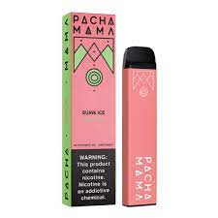
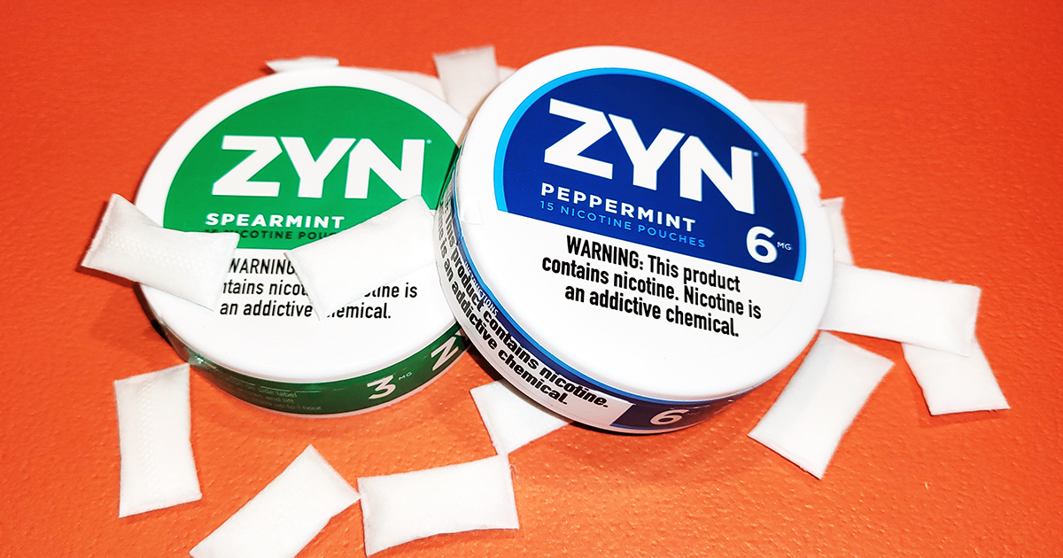
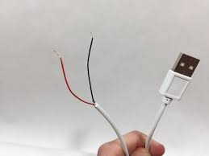
Nicotine/Vaping
Tobacco free doesn’t mean nicotine free!

Slide 13
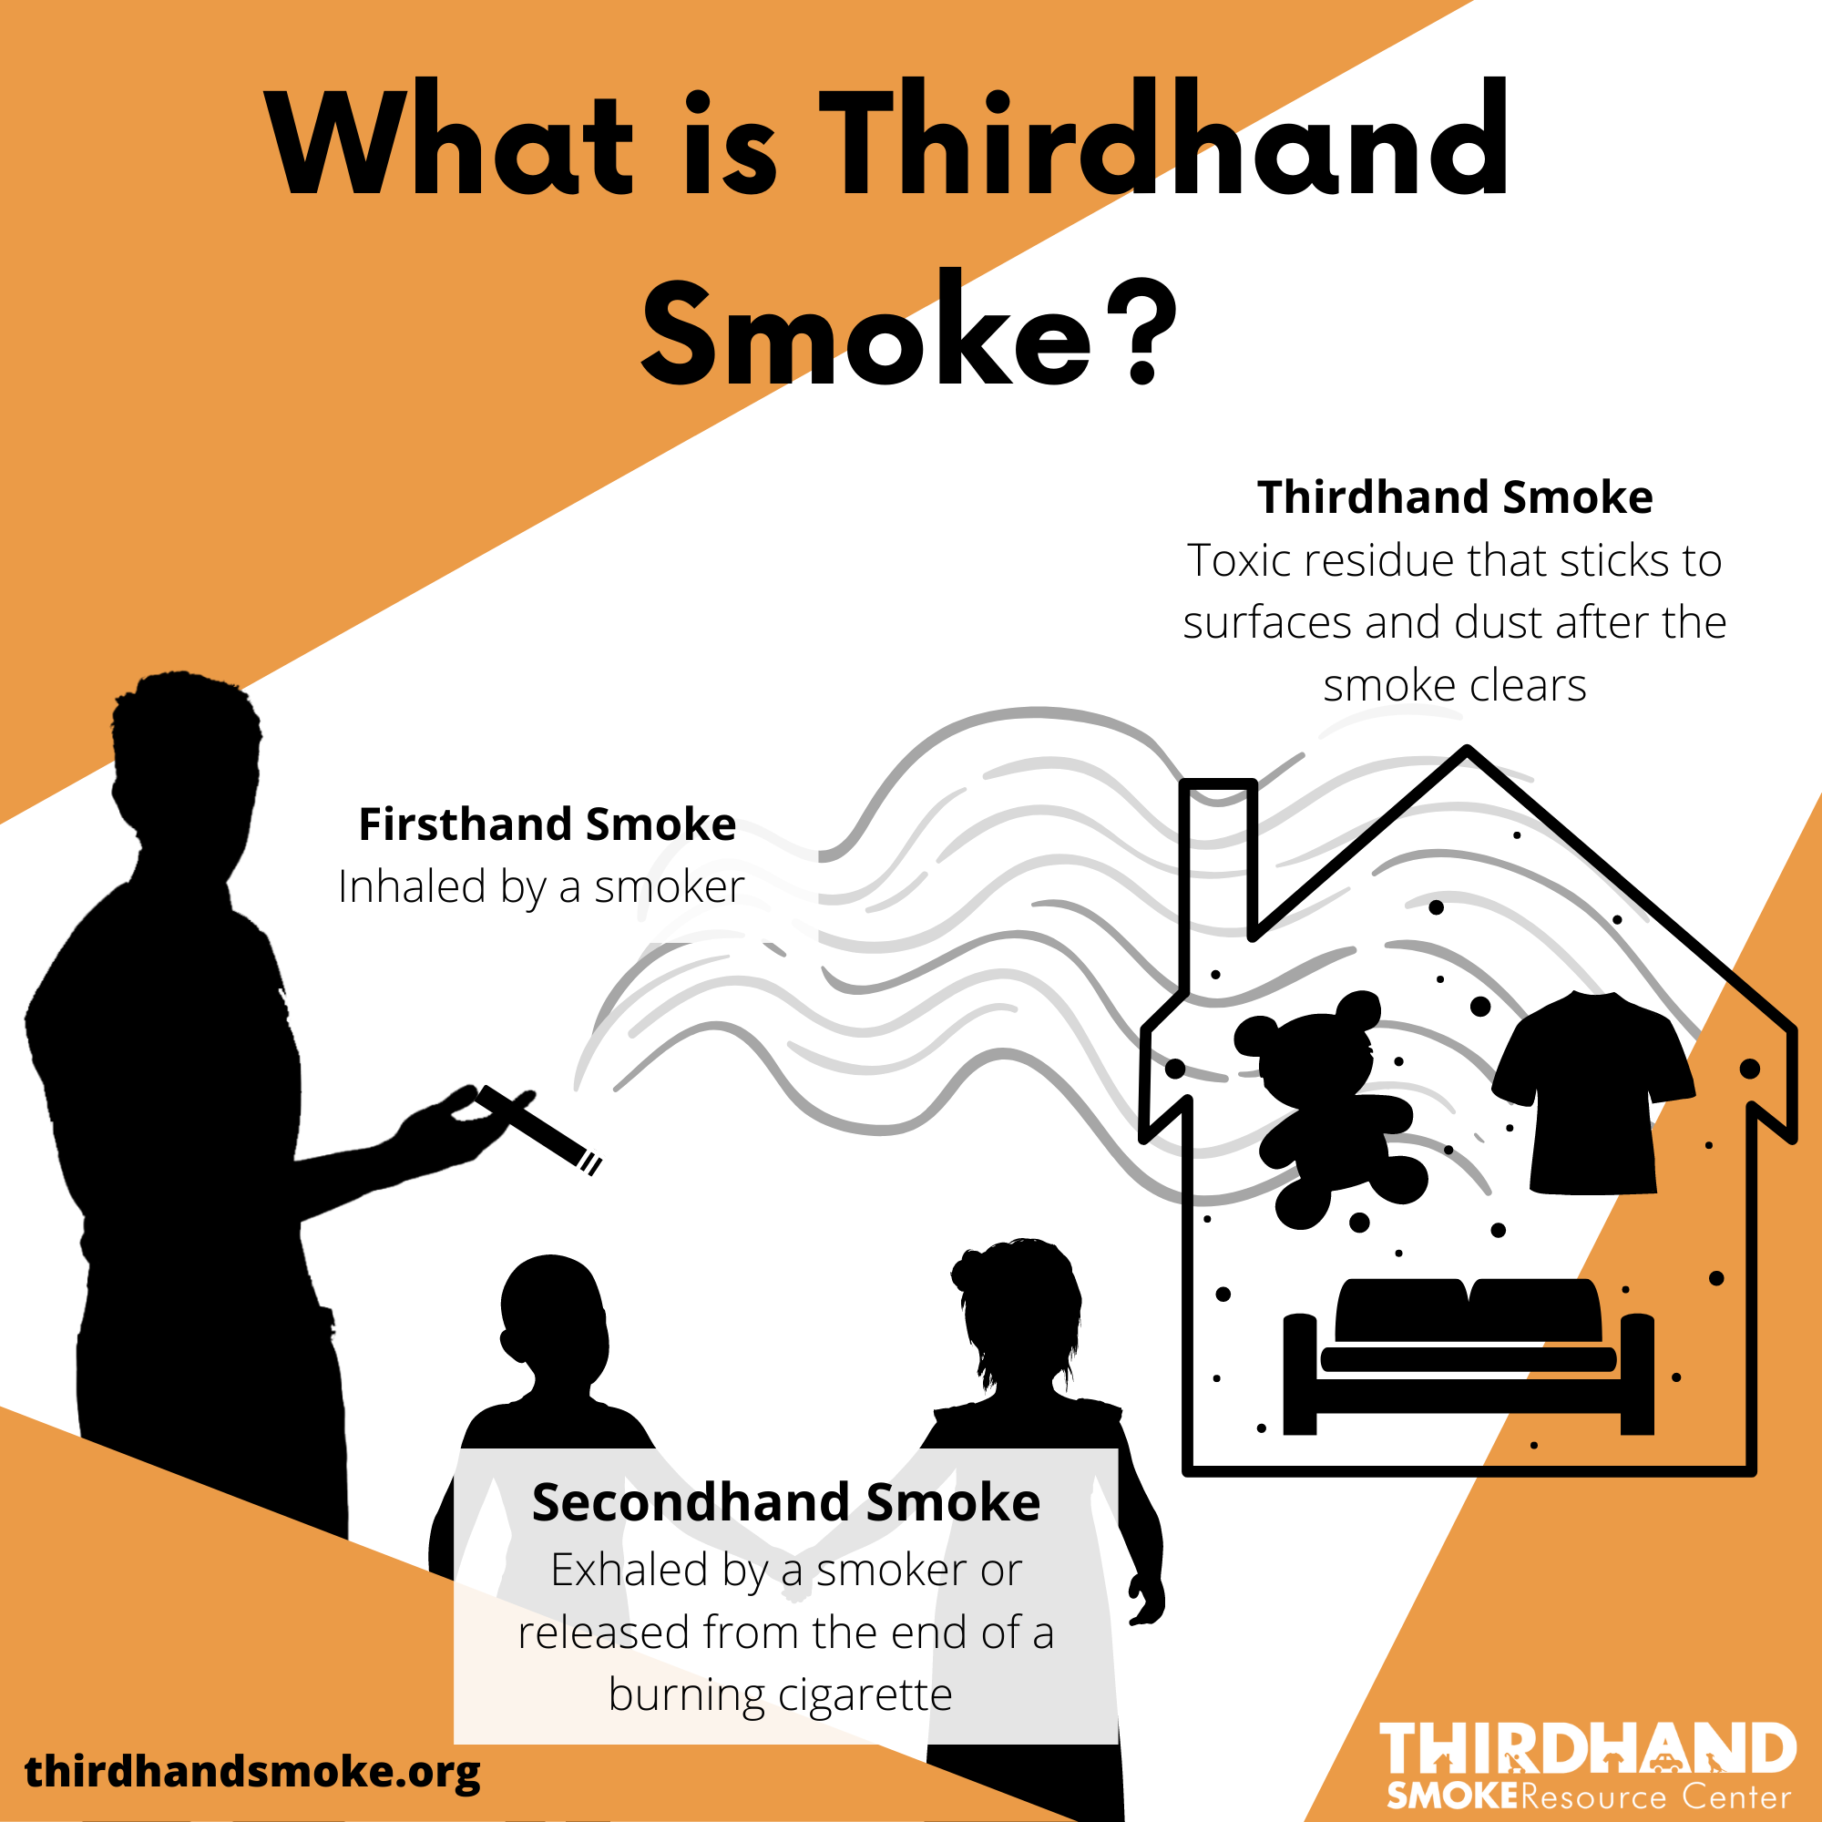

Slide 14
Opioids

Slide 15
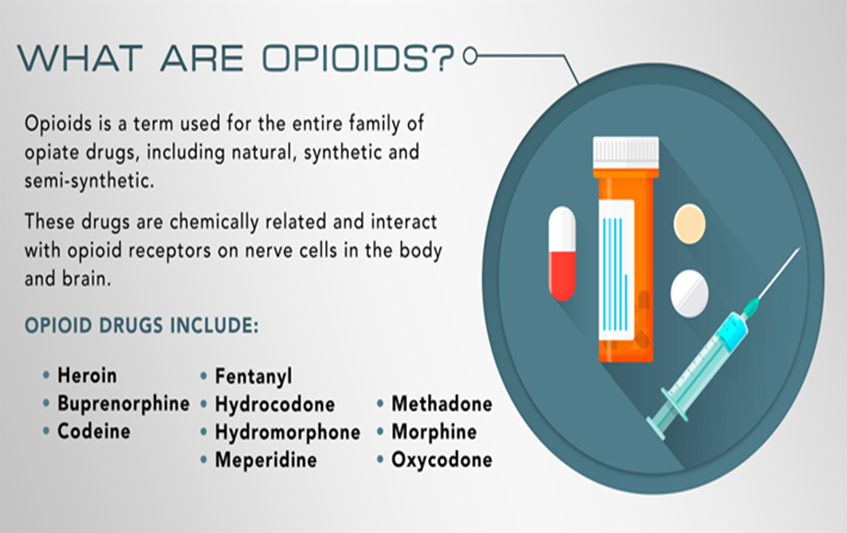
Opioids/opiates are painkillers that are derived from the Poppy plant.
Opioids- synthetic
Opiates- natural
Opiates are labeled “natural”, because nature creates the active ingredient molecules. Common opiates include opium, morphine and codeine, which are made directly from poppy plants. An opioid is a substance (molecule) that is synthetic or partly synthetic. This means the active ingredients are created chemically. The issue is these are being made in “laboratories” illegally and sold in the street.
Notes:
Kelly

Slide 16
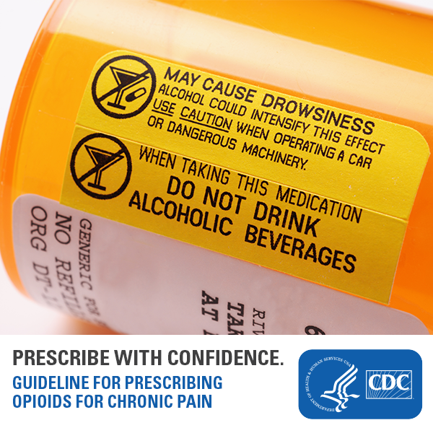
Opioid Intoxication Symptoms
Reduced level of consciousness
Pinpoint pupils
“Nodding”
Slurred speech
Depressed respiratory rate
Hypotension
Blue skin
Hypothermia
Source: NIH
Notes:
Bradycardia- slow heart rate

Slide 17
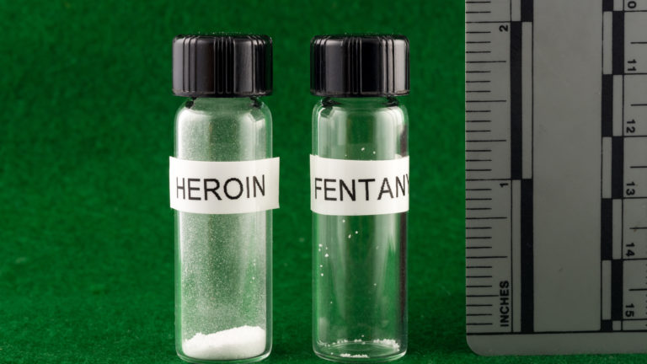
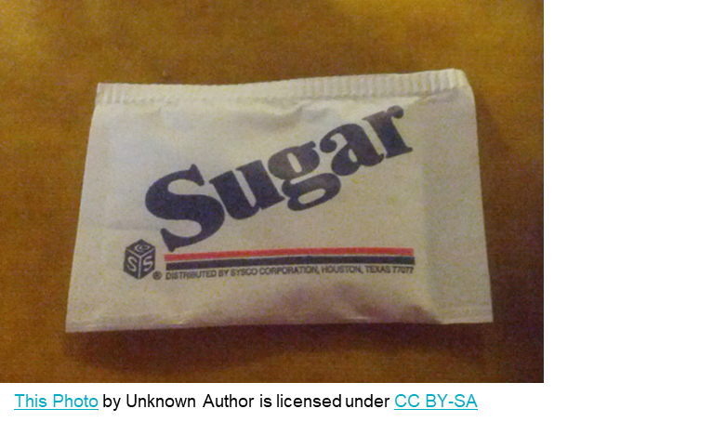
2mg can kill…
•Only 2 milligrams of Fentanyl is considered a lethal amount, depending on the size of the person.
•To appreciate how small 2 milligrams is, a typical sweetener packet on a restaurant table contains approximately 1,000 milligrams.
Source: DEA
Notes:
Picture: Potentially lethal dose of heroin vs potentially lethal dose of fentanyl

Slide 18
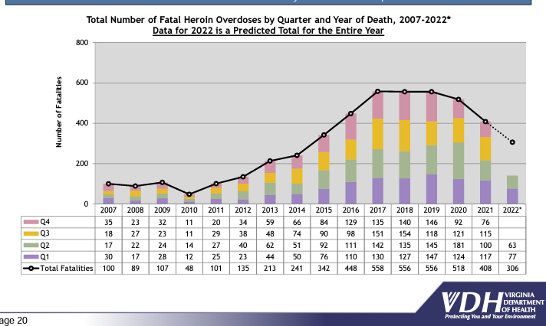
Why is Fentanyl Such a Big Deal?
A little history
Heroin
Red arrow, when fentanyl introduced to heroin. Sharp rise in overdose deaths
Notes:
Arrrow =when fentanyl was added

Slide 19
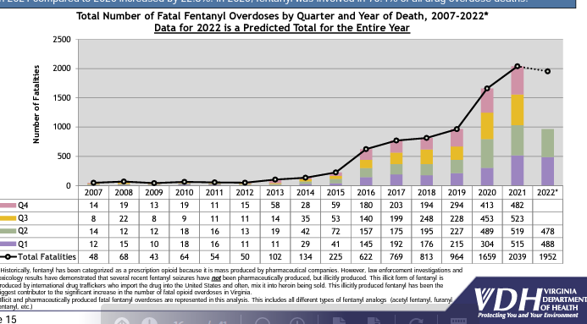
The Rise of Fentanyl

Slide 20
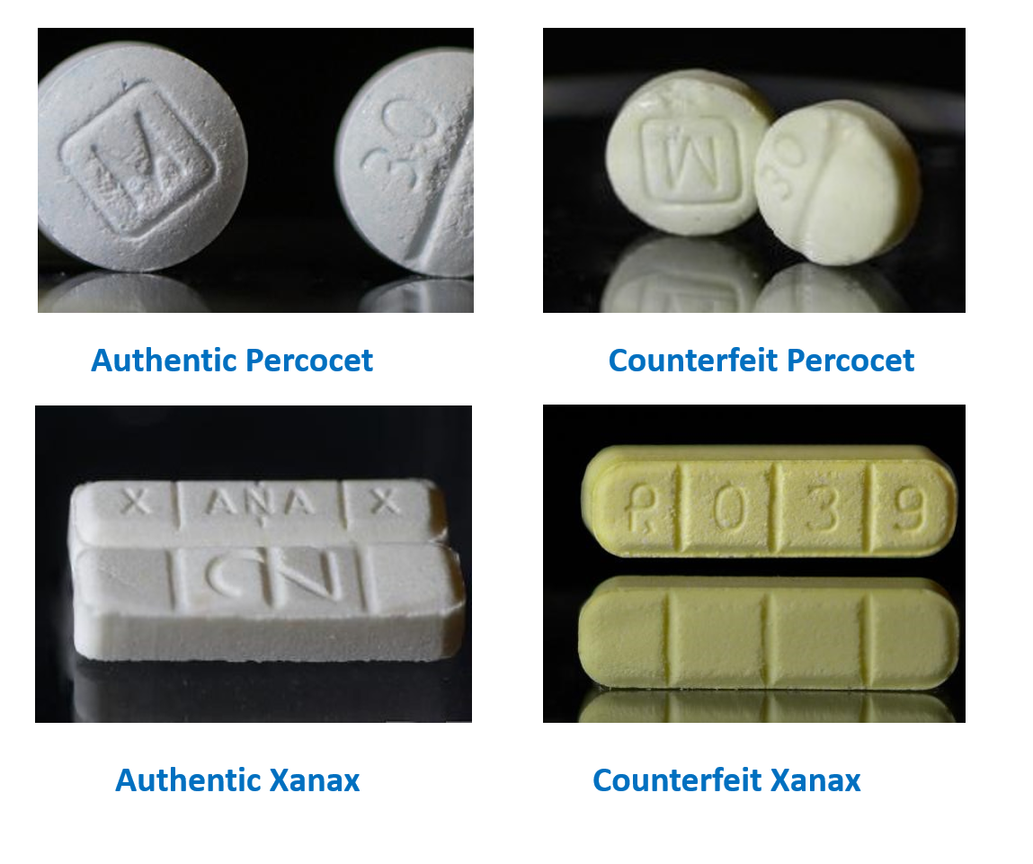
What To Look For
Notes:
FCPD – Anne Rizza
These are some examples of authentic and counterfeit drugs
The labeling in these instances is more significant to investigators than those obtaining them – many times, as I stated before, they are looking for the high and are not overly concerned about the drug that gets them there
Our detectives have been seeing more light blue pills recently

Slide 21
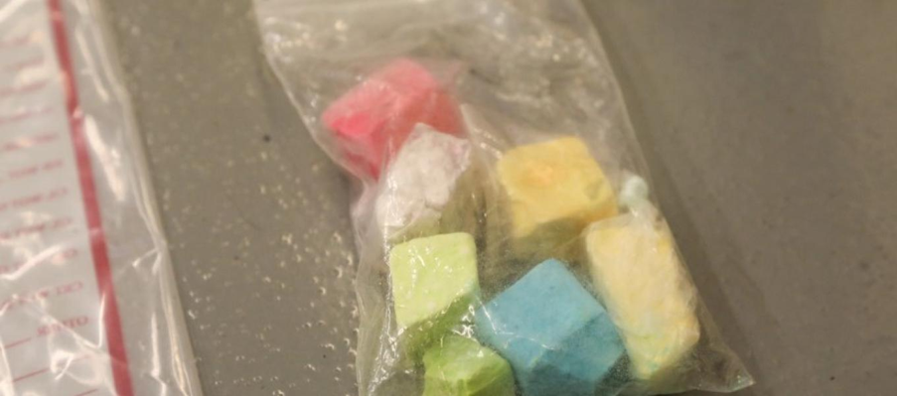
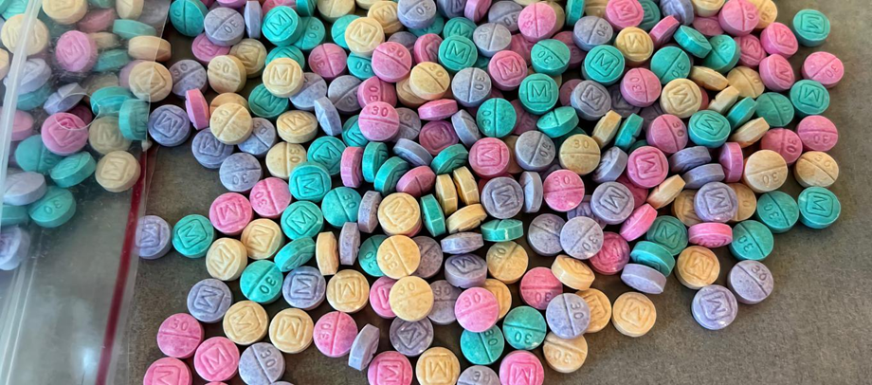
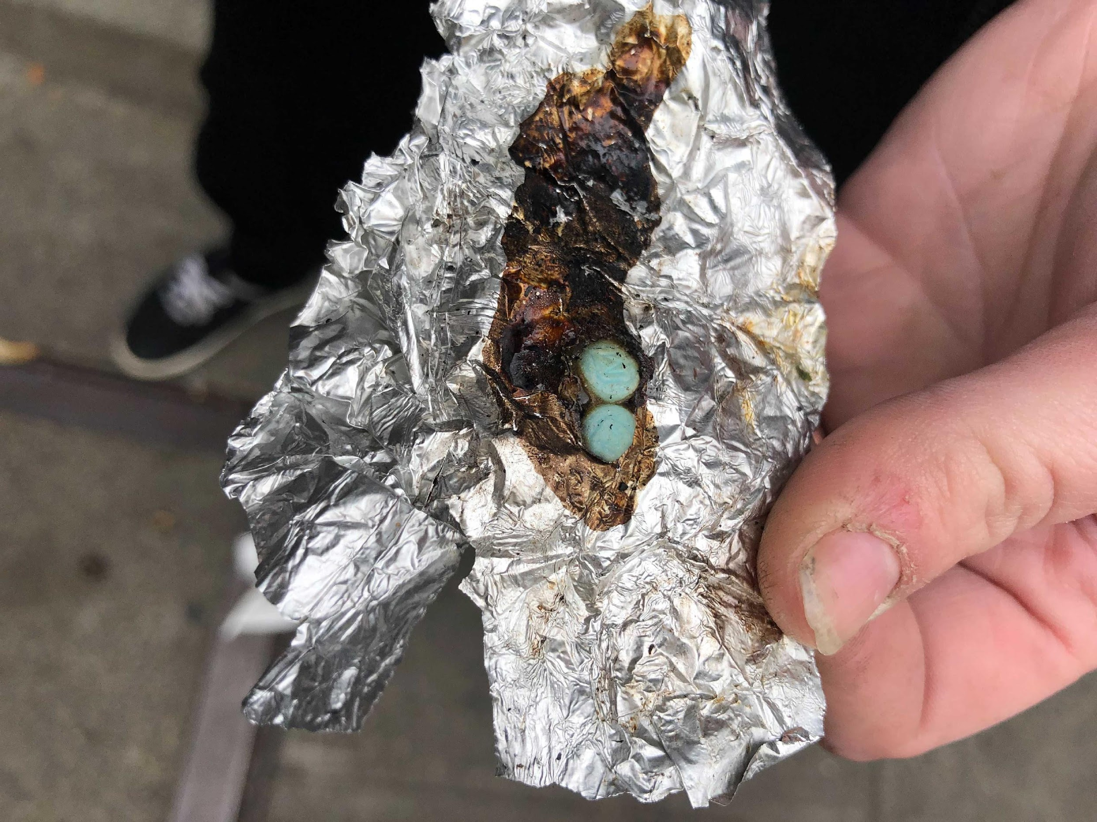
DEA warning- Rainbow Fentanyl
Specifically targeted to teens and young adults.
Resembles sidewalk chalk before pressed.
Youth are smoking pills thinking they won't overdose.

Slide 22
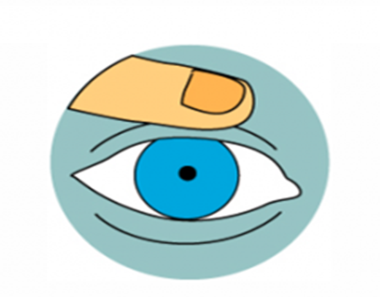
What Does an Opioid Overdose Look Like?
KNOW THE SIGNS
Not Responding
Doesn’t move and can’t be woken
Slow or Not Breathing
A breath every 5 seconds is normal
Making Sounds
Chocking, gurgling sounds, or snoring
Blue Lips & Nails
Cold or Clammy Skin
Tiny Pupils
source: kingcounty.gov
Notes:
FCPS SAPS: Kelly
Not responding, Slow or not breathing, making a gurgling or snoring sound, blue lips, cold or clammy skin, tiny puplis
There is a misconception among our your that getting help for someone might get them in trouble.
It’s important to teach our children that they could be saving a life.
If you have to ask yourself if they are OK, they are not OK, get help

Slide 23
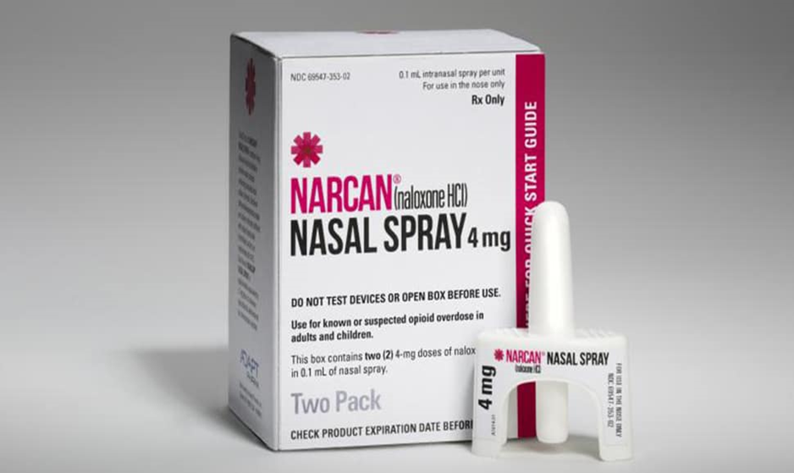
Naloxone (Narcan)
Opioid overdose reversal medication
Non-habit forming
Only for opioid overdoses
911 is essential
Source: WHO

Slide 24
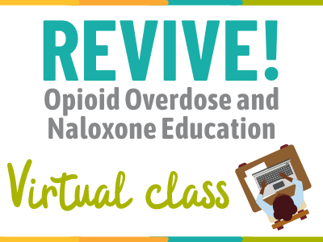
REVIVE!
REVIVE! trains individuals on:
How to recognize the signs and symptoms of an opioid overdose
How to administer naloxone to potentially reverse the effects of an opioid overdose
What to do and not do when responding
Each attendee receives a free REVIVE! kit, which includes all the supplies needed to administer naloxone.
Free Naloxone to Fairfax County residents
Spanish Course Available
More information and upcoming training dates: http://bit.ly/revive-csb
Scan this QR code for more information.
Notes:
CSB – Marla
Will review what’s on the slide

Slide 25
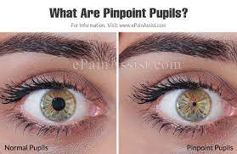
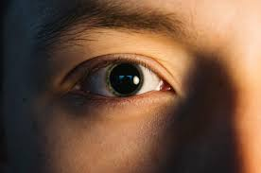
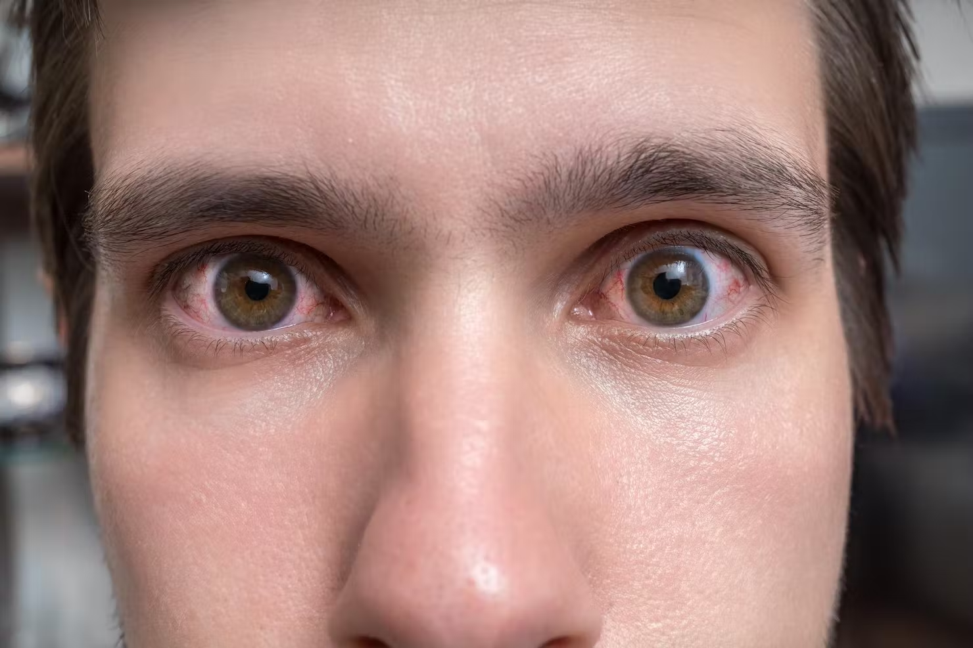
Signs of Intoxication
Mayo Clinic (2021)

Slide 26
Prevention Strategies
Monitor use of prescription medications
Check backpacks
Search internet history
Lock up prescriptions, other commonly abused substances, & alcohol
Parental supervision
Get teens involved with sports/activities/clubs
Be a positive role model
Get child/family treatment for trauma, grief, family addiction, mental health concerns, etc.
Be clear about family rules and expectation. Stick to the consequences.
Have a safety plan with your child
Remember, substance abuse is a symptom! It is often a response to overwhelming feelings of boredom.

Slide 27
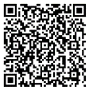
CSB
If the situation is immediately life-threatening, call 911.
Fairfax-Falls Church CSB Emergency Services (24/7) - Available for people who have a mental illness, substance use disorder, and/or developmental disability in need of immediate help
703-573-5679 https://bit.ly/CSB247
CSB Entry and Referral - Assessment and referral services available for youth, adults, and pregnant women including office-based opioid treatment
703-393-8500 https://bit.ly/CSBentry
CSB Fairfax Detoxification Center (24/7) - A short-term residential program to help adults safely detoxify from the effects of drugs and/or alcohol 703-502-7000 https://bit.ly/CSBdetox
CR2 (24/7) - Provides rapid response to children, youth, and adults facing a mental health and/or substance use crisis.
572-364-7390 www.cr2crisis.com
REACH (24/7) - Crisis stabilization for persons with developmental disabilities.
855-897-8278 https://bit.ly/3Lc6YwX
CSB REVIVE! - learn how to recognize and reverse opioid overdoses http://bit.ly/revive-csb
Safe medication storage/disposal – request a free medication lock box/drug disposal kit
http://bit.ly/med-lock-box
Scan this QR code for more information.
Notes:
CSB: Marla
Will review what’s on the slide

Slide 28
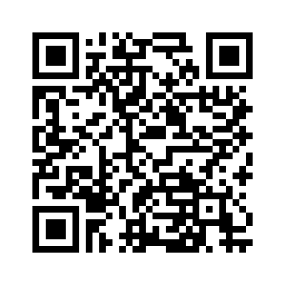
Youth Survey Fall 2022

Slide 29
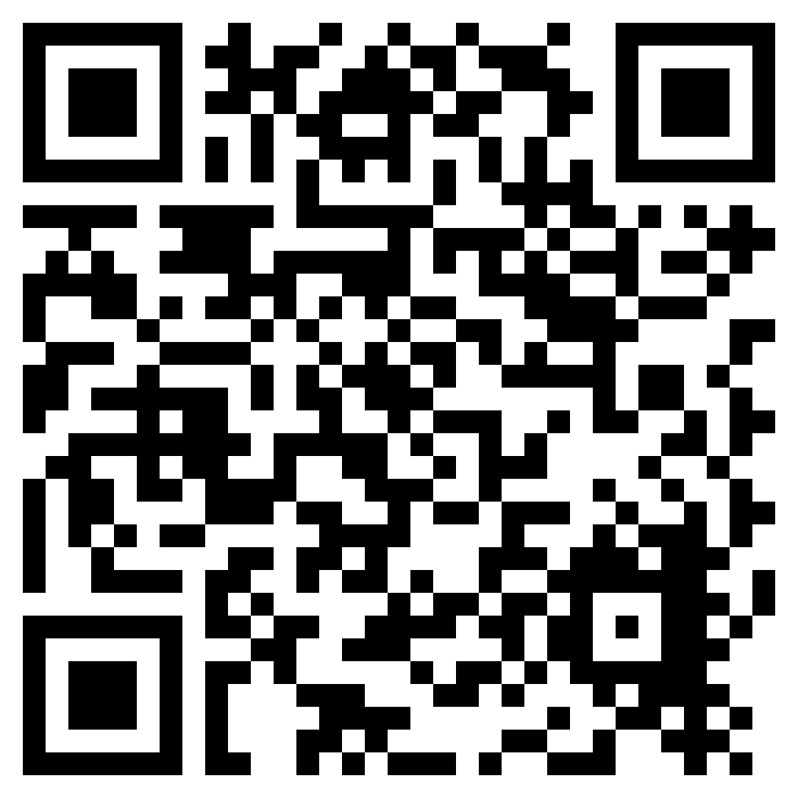
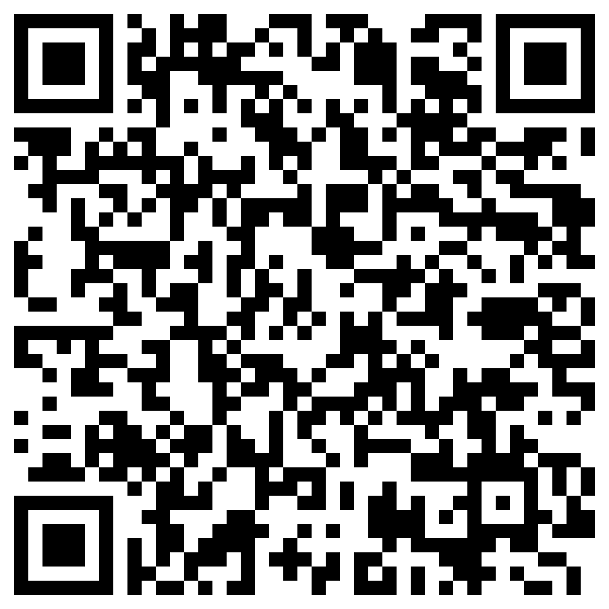
Parent Volunteers Needed
AP Exam Proctors Needed! – Parent volunteers are needed to assist in handing out and collecting materials and supervising AP tests from May 1-11 (two 4-hour sessions per day @ 8am and 12pm) - https://www.signupgenius.com/go/10c0945aea92da2fece9-aptesting#/
All-Night Grad Party (ANGP) - Wed, June 7 - Freshman class parents “pay it forward” by helping to transport supplies from Langley to the party venue - https://www.signupgenius.com/go/10c0945aaaa23a0fcc61-20232?fbclid=IwAR3E4z1XwTPgp0cM_xpyhCWTPWwWbNmci6OfHhIrM3ctb14AVW3xnwoDEjg#/

Slide 30
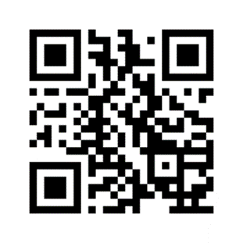
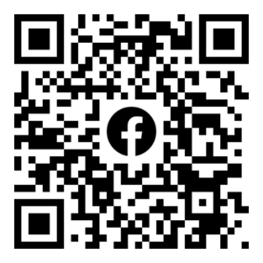
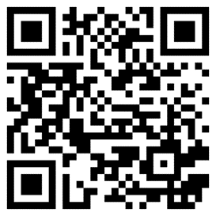
Keep In Touch
Sign-up for Class of 2026 Communications:
Class Parent Mailing List
Langley High School Class of 2026 Parents - Facebook Page
Class of 2026 Website (https://www.ptsalangley.org/class-of-2026)

Slide 31
Coming up next…
Wed, May 3, 9:30am, Cafeteria - PTSA General Membership Meeting - Officer Elections & Guest Speaker, LHS College & Career Specialist, Karen Burke
June 16 – Last Day of Freshman Year!!
In the Fall…
Sophomore Parent Fall Coffee – tentative topic “How to Use Naviance”
Homecoming - expect it to be early again!
Sophomore Class Dinner - likely early Spring

